Slide 1

Welcome!
Habitat Jumpstart Workshop

Slide 2
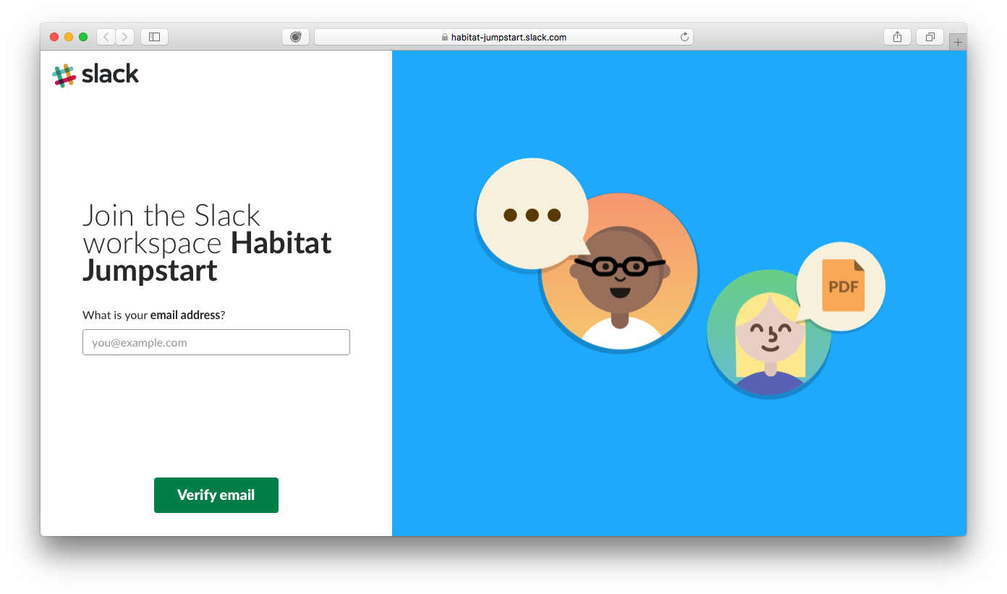
Join the workshop Slack
https://goo.gl/AdTNpW

Slide 3
Today's Workshop
Quick Introduction to Habitat
Log into your workshop Linux workstation
Set up your Habitat Builder account
Build deploy a Node.js application with Habitat
Build deploy manage a Java/Tomcat application with Habitat
Bindings
Deploying
Building with Builder
Notes:
Points to hammer home:
We use a tool like Chef to automate the remediation - no hand-fixing nodes, ensure future nodes don't fail in the future
Even if the remediation is a small change, we test our remediation to gain confidence that it will not adversely impact our fleet

Slide 4
Shifts in modern applications An introduction to habitat

Slide 5

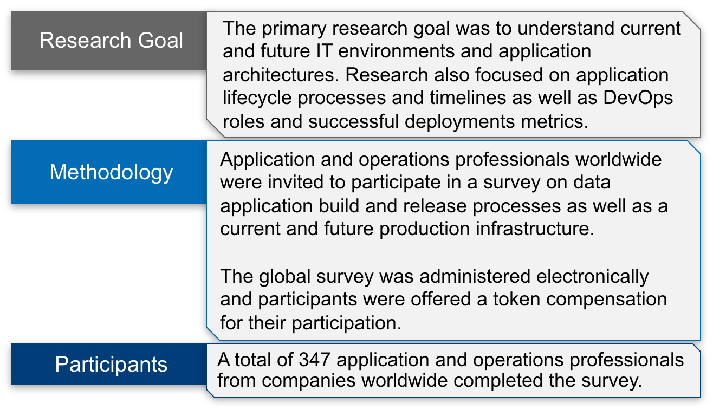

Chef's 2018 State of Application Delivery Survey

Slide 6
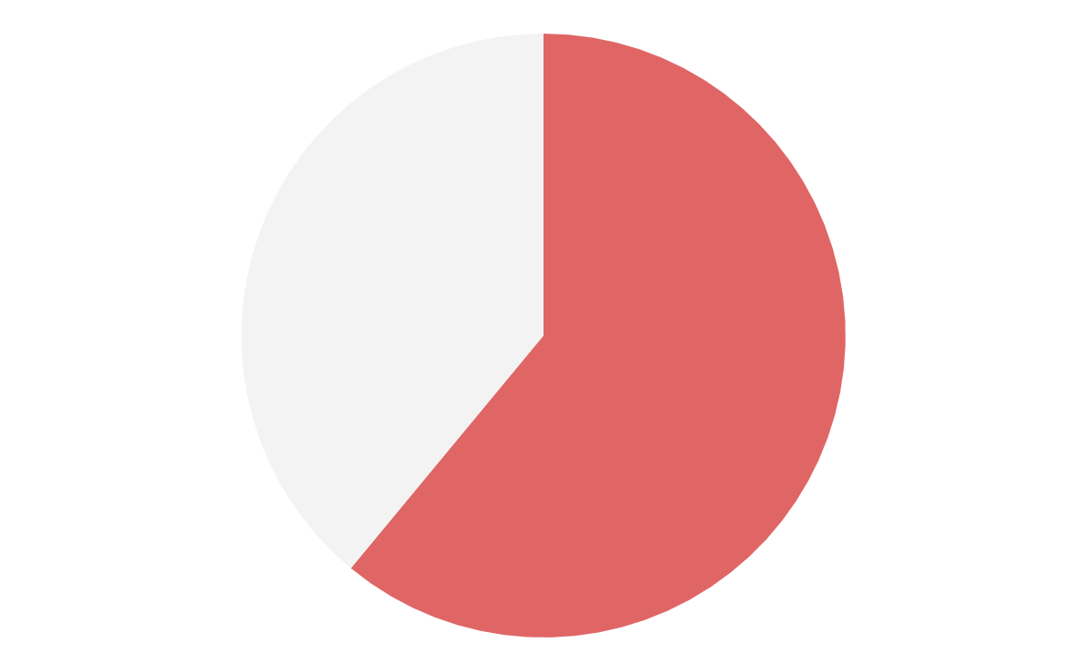
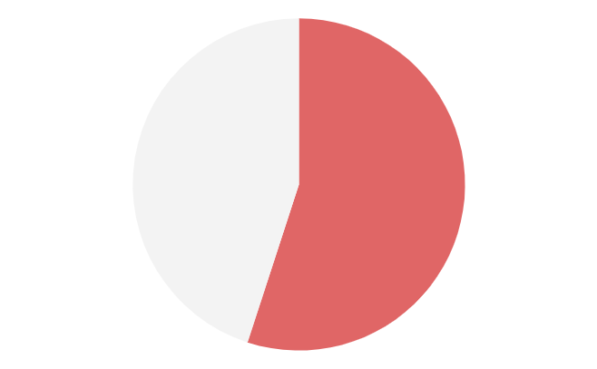
Survey Insights
How do you measure app deployment success?
How long does it take to complete the app build process?
How many builds before an app is deployed to production?
72%
46
45
61%
55%
34
Speed*
Days or Longer
Four or More
Speed is success for applications - but achieving speed is a big challenge.
* “Time from code to production” or “Time from commit to deploy”
Notes:
Under pressure to deliver on speed - it’s not easy.
Speed - 72% say most important measure of app deployment success But - It takes 60% of respondents days, weeks or months to complete the build process for applications. 51% need 4-10 builds before an app can be deployed

Slide 7
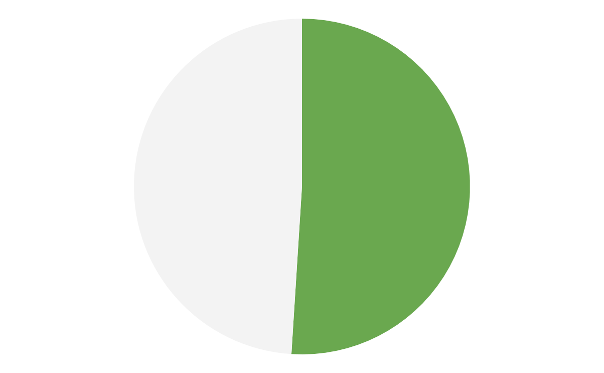
Survey Insights
Aggressive plans for containerization, most often by lifting, shifting, and modernizing applications.
Speed is success for applications - but achieving speed is a big challenge.
In 2 years, what percent of your apps will be deployed on container platforms?
Which approach will you use to transition apps to new architectures & infrastructures?
73%
52%
51%
1/4 or More
Lift, Shift, Modernize
Rewrite Apps
Notes:
Aggressive plans to modernize applications.

Slide 8
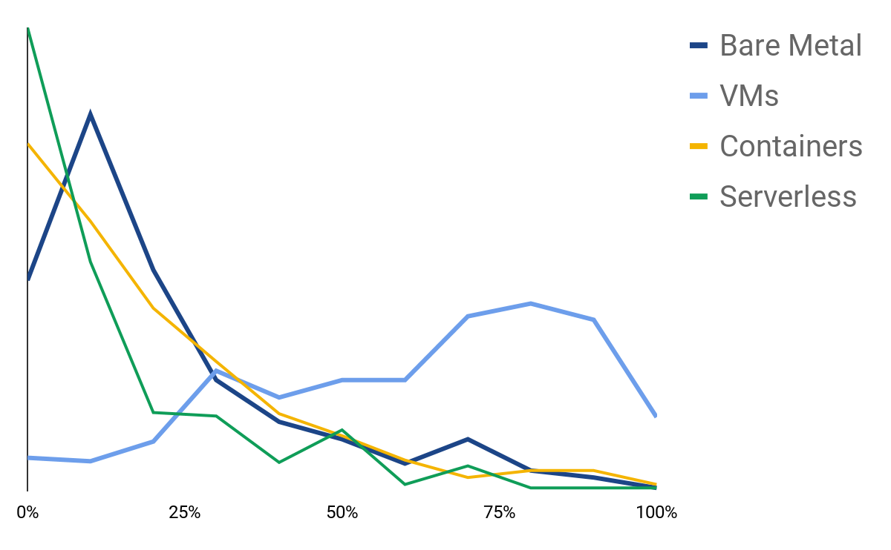
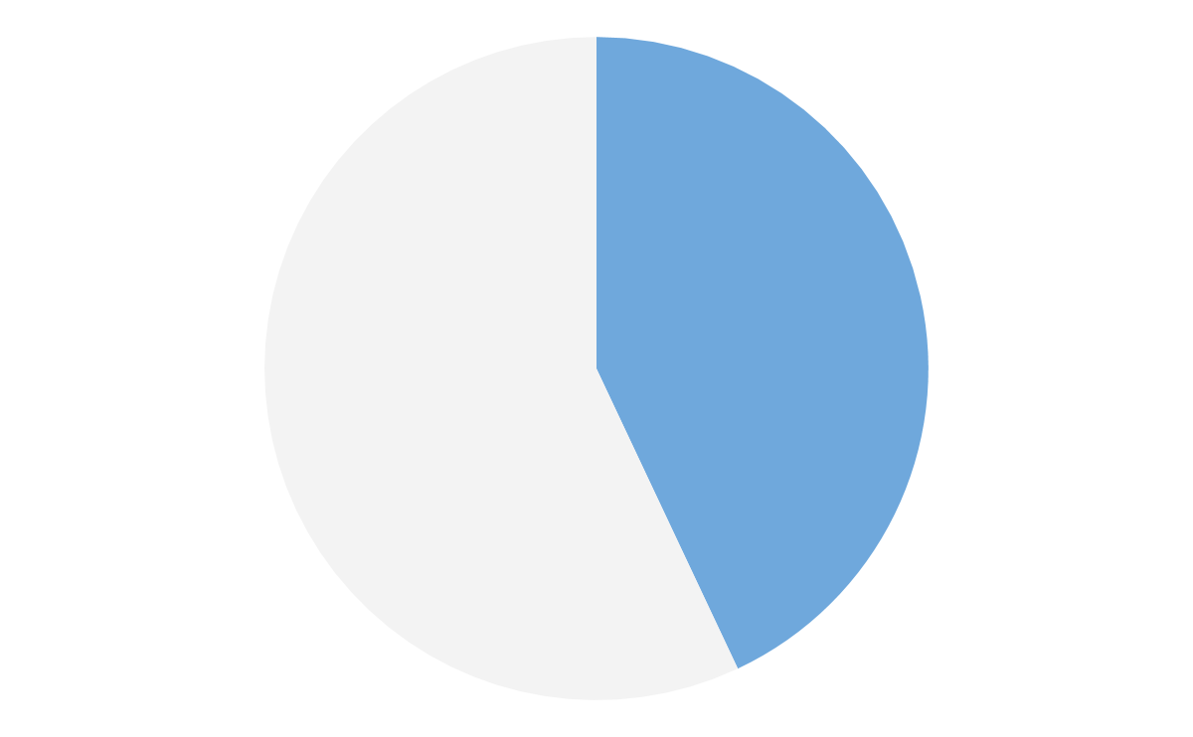
Survey Insights
Speed is success for applications - but achieving speed is a big challenge.
Aggressive plans for containerization, most often by lifting, shifting, and modernizing applications.
What percent of production apps run in the following environments?
Which is the most challenging aspect of the application lifecycle?
Environments are heavily heterogeneous, and application management is most challenging.
44%
Management
Notes:
But management is a challenge in a heterogeneous world - it’s going to get harder.

Slide 9
In search of speed, organizations are moving to the next platform while carrying legacy weight.
It’s already difficult to manage. It’s going to get harder.
Now is the time to think about a comprehensive application strategy.

Slide 10
The Way We Build Applications Is Wrong
The business value is in the application, yet we spend so much time maintaining and worrying about infrastructure. This doesn't change with containers.
Business App 1
Business App 2
Business App 3
Business App 4
MSVC, COM+, etc.
MS .NET 2.0
IBM WebSphere
Tomcat 6 / Java 7
Windows 2003
Windows 2008 R2
Red Hat Linux 5
Red Hat Linux 6
In addition, every application has its own path to production: its own CI/CD, its own monitoring, its own compliance, its own ARA...

Slide 11
Heterogeneity is the present and future of IT
How can we cleave the business value - the application - from the underlying infrastructure so we can manage it better?
Business App 1
Business App 2
Business App 3
Business App 4
89% desire a cross-environment application packaging solution.

Slide 12

“Lift & Shift” Legacy Apps to Modern Platforms Organizations struggle to move existing, business critical apps to modern platforms
Deliver on a Cloud-Native (Cloud/Containers) Strategy Organizations hit a wall when adopting and deploying to a cloud-native platform
Habitat enables application teams to build, deploy, and manage any application in any environment - from traditional data centers to containerized microservices.
Notes:
We call this "application automation", so if you hear that buzzphrase, that's what we mean -- all the things that it takes to make this goal true. And yes, it works equally well for modern, greenfield, containerized microservices, but we aren't here to primarily talk about that today.

Slide 13



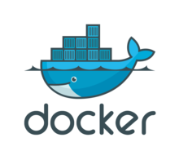



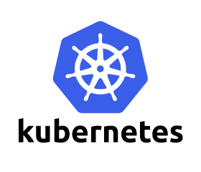




How does it work?
It splits the platform-independent part of the application from the platform-dependent part.
BUILD
DEPLOY
MANAGE
Ring Supervisor
Platform-Independent Build
Export
Platform-Dependent Deploy
Notes:
Build: Platform (infrastructure) independent
Deploy: Platform (infrastructure) dependent

Slide 14
How does it work?
Application
Application Libraries
Application &
Libraries
Libraries
Operating System
OS
All of the problems shown previously are a result of this pattern: building up from the operating system.
The entire triangle becomes the artifact you carry around with you now and in the future (including sometimes the VM and the server!)
Habitat builds from the application down
Embedded supervisor as management interface
Builds have strict dependency version control
Notes:
Works on both Linux and Windows

Slide 15

Building Applications with Habitat
Packaging Applications
PLAN
ARTIFACT
DEPOT
USER
Running Applications
BARE METAL
SUPERVISOR
DEPOT
SERVICE
ARTIFACT
CONTAINERS
SUPERVISOR
SERVICE
IMAGES
SUPERVISOR
SERVICE
VM
SUPERVISOR
SERVICE
Notes:
Applications built with Habitat starts with a plan which describes how that application is built, configured, and run. Habitat then executes that plan and builds an immutable artifact that contains your software, any of its runtime dependencies, and configuration to run that software. That artifact can then be uploaded to a depot and then because it already contains every dependency it needs to run, can be deployed into any runtime environment including bare metal, VM, container. Build it once, deploy it in any environment.

Slide 16
Deploying & Managing Apps with Habitat
Running Applications
Topologies
Update Strategies
SUPERVISOR
SERVICE
LEADER
ALL AT ONCE
SUPERVISOR
SUPERVISOR
SERVICE
SERVICE
SUPERVISOR
SUPERVISOR
STAND ALONE
SERVICE
SERVICE
ROLLING
SUPERVISOR
SERVICE
LEADER ElECTION
Notes:
Build and deploying your application are not enough. Modern applications are dynamic and need to find other services they are dependent upon. They have different topologies, and need to be updated.
Once deployed, applications built by Habitat have a supervisor which manages the service, but also the dynamic configuration allowing it to reconfigure based on different topologies such as leader follower. The supervisor can manage the update strategy for your application so that when a new build is pushed to the depot, the supervisor can deploy that new version using one of the update strategies like at-once or rolling deployment.

Slide 17
Section 1:
Workshop Setup

Slide 18


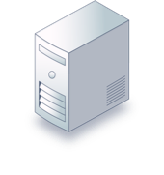

Workshop Learning Environment
Your GitHub Account
Code repo
Grants authorization to use Hab Builder
Your Habitat Builder Account
Your project Origins (associated to Github repos)
Your access keys and tokens
ssh
For purposes of workshop, everyone will use a standard VM to develop Hab packages. In normal everyday use you can use Hab Studio on your personal laptop if you chose; a VM workstation is not a requirement to use Habitat!
Your Laptop
Linux VM workstation /w
Habitat Studio
Notes:
This workshop’s learning environment is made up of:
Many nodes, at least one per participant
Each node sends data to the Chef Automate instance
A laptop for each particpant, that’s the computer sitting in front of you
One workstation for each participant that will be used for developing Chef code
Each participant will ssh into one workstation
Each Chef Development Workstation will ALSO be a Node!!

Slide 19
Lets Begin
$ vim <file>
$ nano <file>
$ emacs <file> (just kidding!)
Everything you need to do in this class will be run from the command line in your Linux workstation, run as the `hab` user.

Slide 20
VM Workstation Login
Your IP is written on the piece of paper you received when you arrived
ssh hab@<YOUR IP ADDRESS>
Password: chefhab1!
Once logged in “claim” by creating a file with your fullname, `sudo touch <your fullname>`
$ ssh hab@<YOUR IP ADDRESS>
hab@<YOUR IP ADDRESS> password: chefhab1!
$ cd ~
$ touch <your first_AND_last name>

Slide 21
Install the latest version of Habitat
On your VM workstation, logged in as the hab user
$ curl https://raw.githubusercontent.com/habitat-sh/habitat/master/components/hab/install.sh | sudo bash
You should see that Habitat is now installed
$ hab --version

Slide 22
Section 2:
Builder Account
Setup

Slide 23
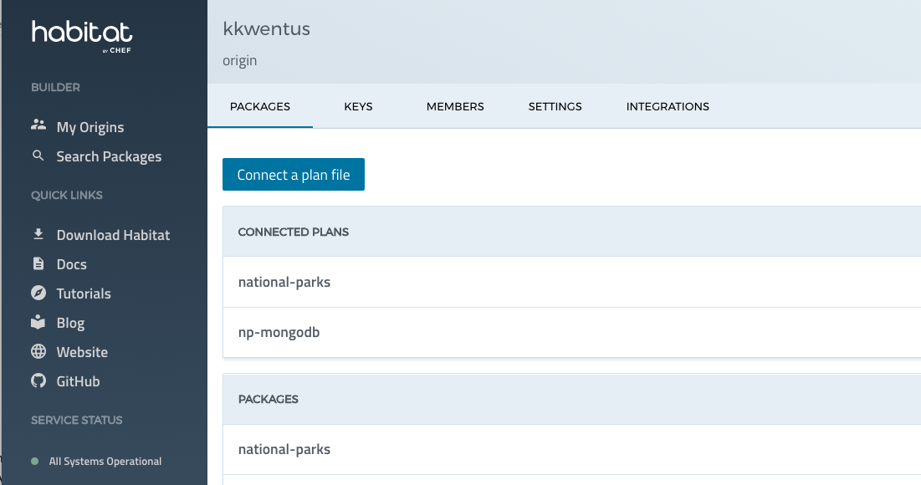
What is Habitat Builder?
A Publicly Hosted Habitat Service
Private version now available
Manages Origins
A logical construct, could be a business, a division, a project or an individual
Has associated Habitat Build Plans from GitHub application repos
Manages Habitat packages
Habitat packages are the results of executing a Build Plan

Slide 24
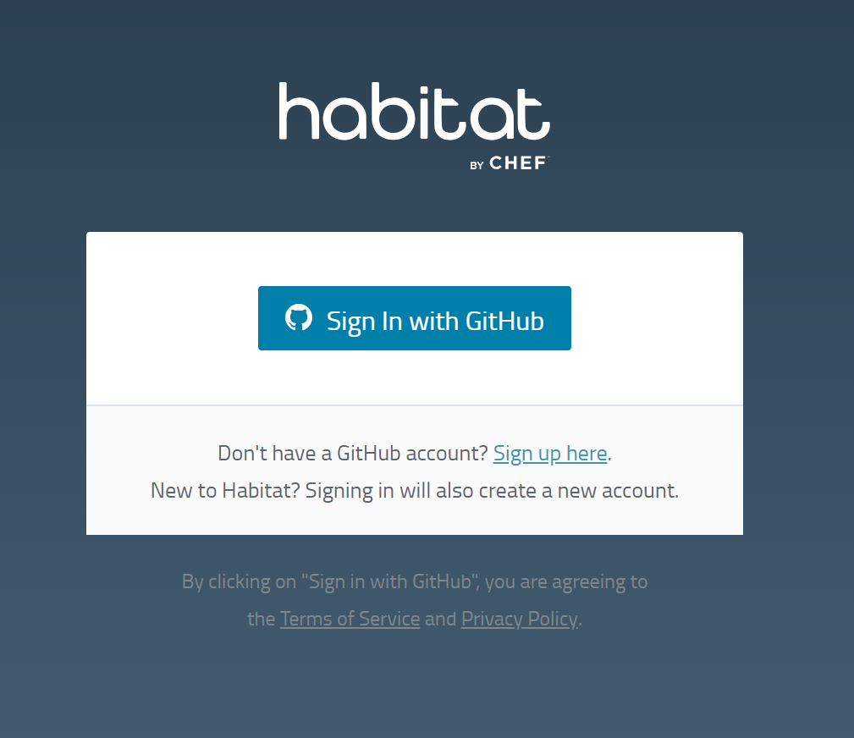
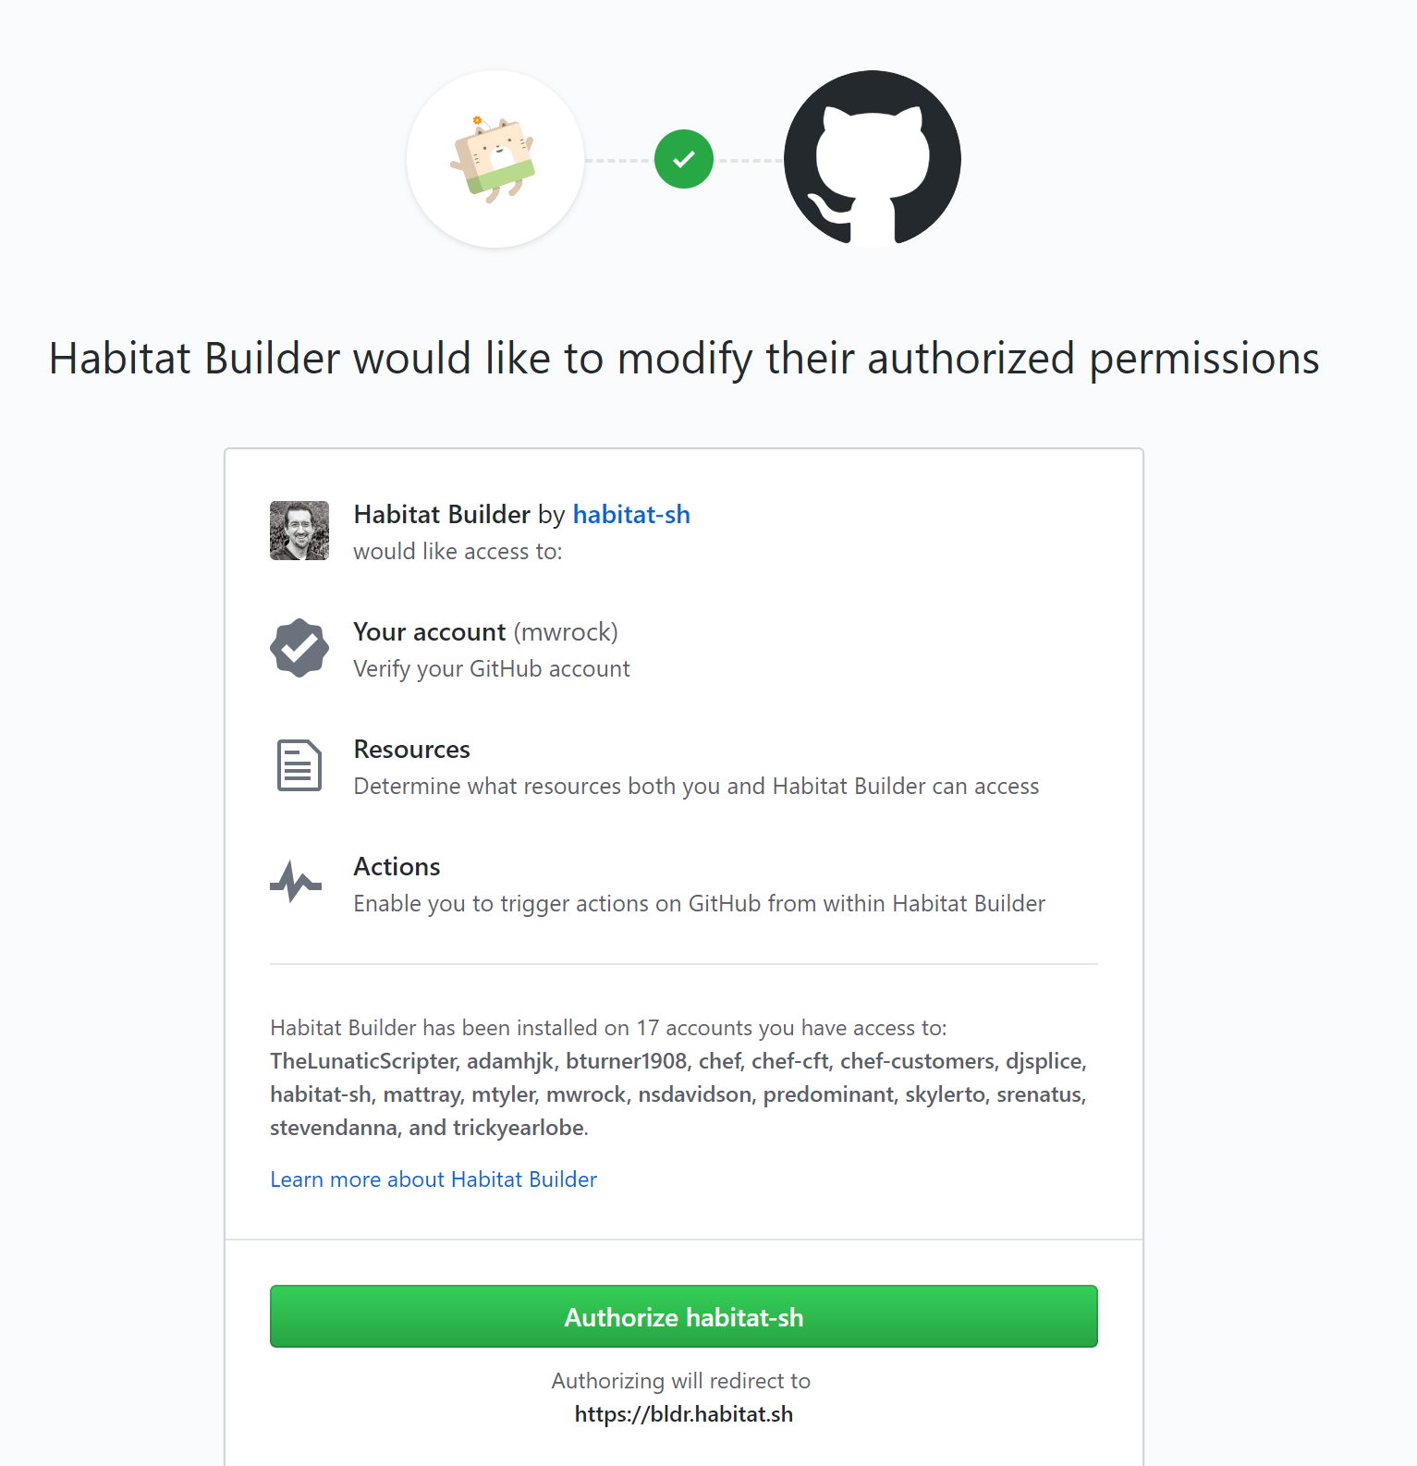
Setup your Habitat Builder account
GitHub accounts are integrated into Builder.
If you don’t already have a GitHub account, FIRST create one at https://github.com
Sign into Habitat Builder: https://bldr.habitat.sh/#/sign-in
Allow it to authorize the permissions to GitHub

Slide 25
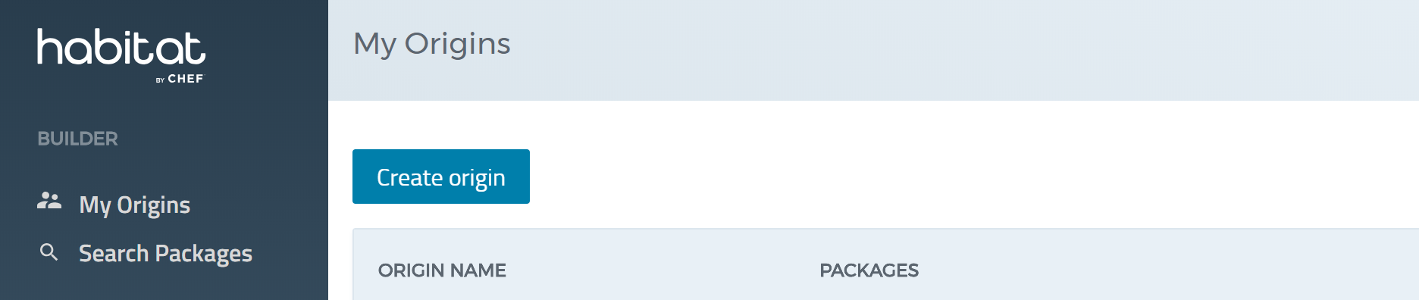
Setup your Habitat Origin
Select “Create Origin” in Builder

Slide 26
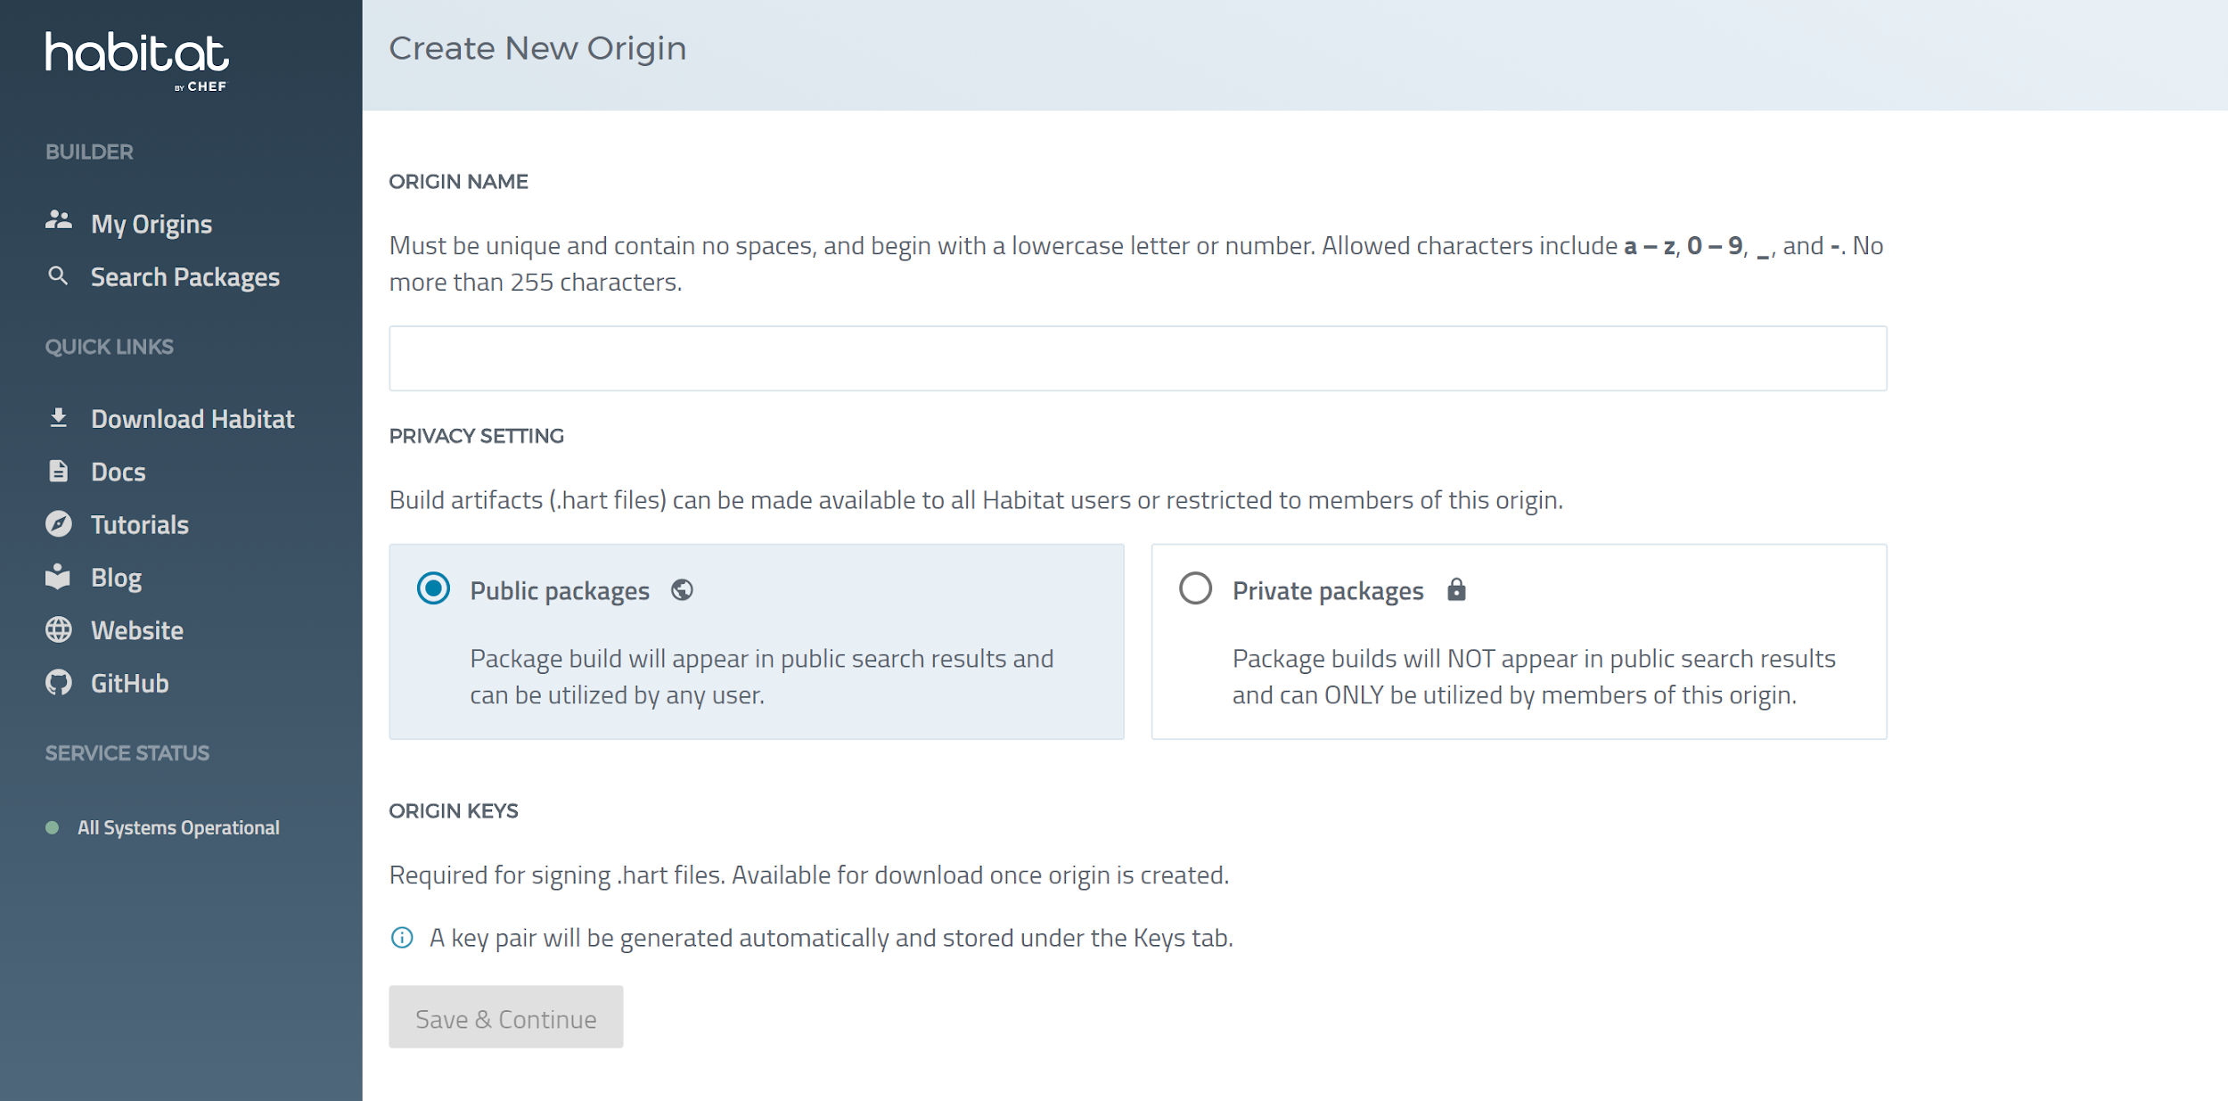
Setup Your Habitat Origin
Input your desired Origin Name.
Recommended Origin Name: Use your shortname or fullname. No Spaces!
Select “Public Packages”
Save

Slide 27
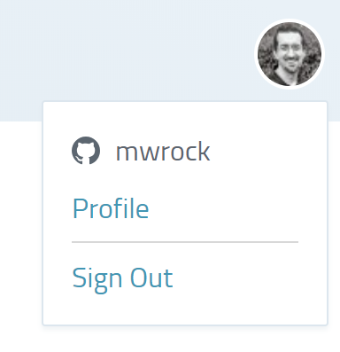
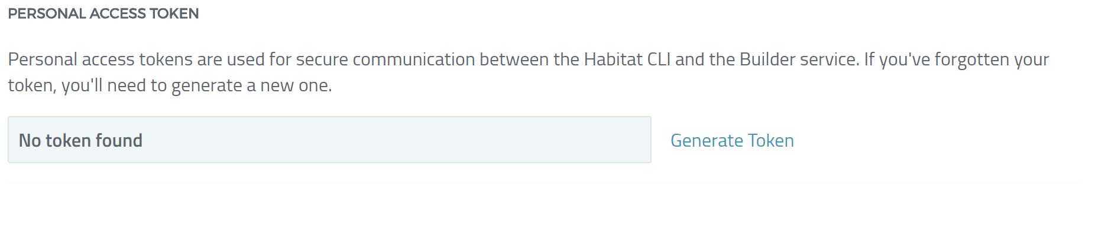
Setup your Access Token
Select your Profile (upper right hand corner in Builder)
Select “Generate Token”
Copy generated token for use on next slide

Slide 28
Setup Habitat CLI
$ hab setup
Habitat CLI Setup
=================
…
Set up a default origin? [Yes/no/quit] Yes
…
Default origin name: [default: chef] <your origin>
…
Create an origin key for `<your origin>'? [Yes/no/quit] Yes
…
Set up a default Habitat personal access token? [Yes/no/quit] Yes
…
Habitat personal access token: <paste your personal access token here>
…
Set up a default Habitat Supervisor CtlGateway secret? [Yes/no/quit] no
…
Enable analytics? [Yes/no/quit] no

Slide 29
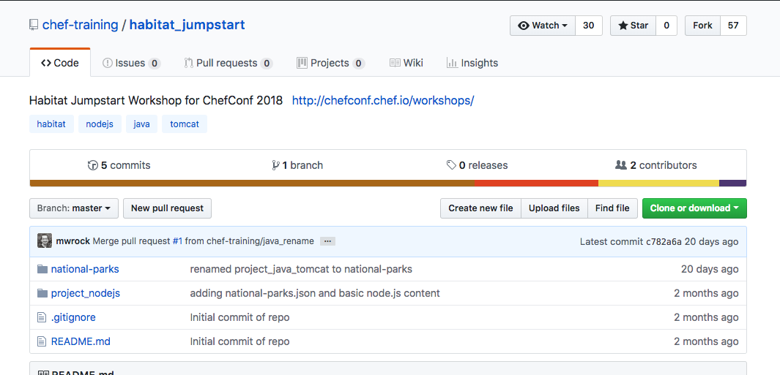
Fork the habitat_jumpstart Repository
Navigate to https://github.com/chef-training/habitat_jumpstart and fork the repository to your personal account

Slide 30
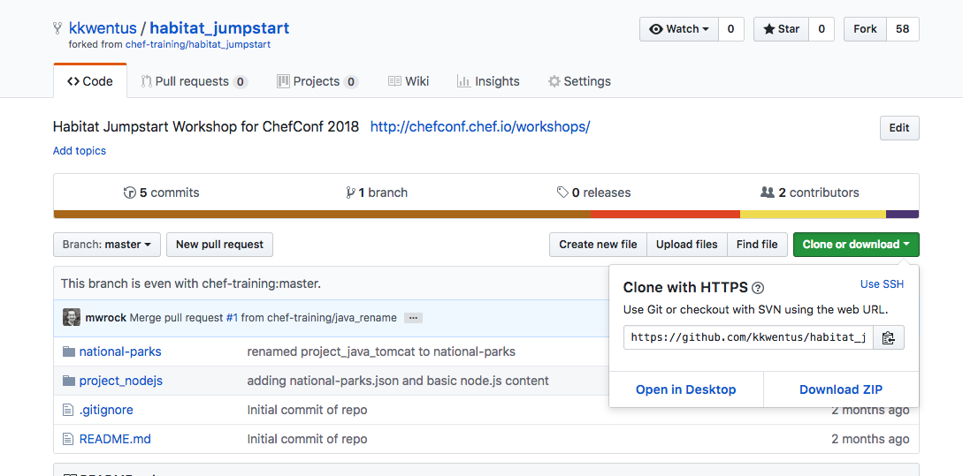
Clone *YOUR* habitat_jumpstart GitHub repo
$ git clone https://github.com/<YOUR GIT USER NAME>/habitat_jumpstart

Slide 31
Section 3:
Node.js app
Build, deploy, manage a Node.js application with Habitat

Slide 32
Node.js app Overview
Super simple “Hello World” Node application
Leverages Habitat Scaffolding
A “warm up” to using the Habitat Studio, Supervisor and Docker Exporter

Slide 33
What is Scaffolding?
A build framework available for many common languages.
Adds language specific “know how” to a Habitat plan
Avoids the need to create bespoke build scripting for common runtimes
hab plan init can inspect your application and possibly detect the correct scaffolding to use
Node, Ruby, Go, Gradle
If there isn’t a scaffolding for your language of choice, its okay because Habitat plans are still super straightforward and lightweight to use
We will do this later in the workshop today

Slide 34
How do you use Habitat to build an app?
Install the Habitat on your workstation
Gets you the CLI and Hab Studio
Create a plan.sh file for your application
Tells Habitat what and how to build
Launch Hab studio
Your development clean room
Run a Habitat package build
Uses the plan.sh
Load/run the Habitat package
Your package will have your app, all the dependencies, it needs to run bundled in and a Hab Supervisor to take care of upgrades and health
Tell your old build process Goodbye; its not you, its them.

Slide 35
Create a plan.sh for your application
$ cd habitat_jumpstart/project_nodejs
$ hab plan init
» Attempting autodiscovery
No scaffolding type was provided. Let's see if we can figure out what
kind of application you're planning to package.
» We've detected a Node.js codebase
→ Using Scaffolding package: 'core/scaffolding-node'
hab plan init auto-detects and uses Node “scaffolding” to generate a basic plan specifically for a Node application.

Slide 36
What happens after hab plan init?
$ tree habitat
habitat
├── config
├── default.toml
├── hooks
├── plan.sh
└── README.md
2 directories, 3 files

Slide 37
Look at the contents of the plan.sh
$ cat habitat/plan.sh
pkg_name=project_nodejs
pkg_origin=mwrock
pkg_version="0.1.0"
pkg_scaffolding="core/scaffolding-node"

Slide 38

What is Hab Studio?
Minimal CHROOTed “scratch” Linux environment
Your development ‘clean room’
Mounts local hab keys and source code only
Is the Habitat build system
Hab studio is where you will go to build and deploy applications locally
Has a Hab supervisor to run the packages

Slide 39
Build your application in Hab studio
$ hab studio enter
[default:/src:0]# ls
README.md app.js bin default_config.json habitat package.json public routes views
[default:/src:0]# build
: Loading /src/habitat/plan.sh
project_nodejs: Plan loaded
Habitat will look for the /habitat/plan.sh file in the context of the folder from which you launched Hab Studio
Result of a build in Habitat is a “package” (with extension .hart)
Notes:
Lets use this as an opportunity to discuss different “flavors” of studios (container, vs chroot and mac vs. linux)

Slide 40
Run the Hab package from studio
[default:/src:0]# source results/last_build.env
[default:/src:0]# hab svc load $pkg_ident
[default:/src:0]# hab pkg install core/curl -b
[default:/src:0]# curl http://localhost:8000
<!DOCTYPE html><html><head><title>Habitat - The fastest path from code to cloud native.</title><link rel="stylesheet" href="/stylesheets/style.css"></head><body><h1>Welcome to the Habitat Node.js sample app.</h1></body><section class="logos"><div class="habitat-logo"><img src="images/habitat-logo-by-chef.svg" alt="Habitat logo"></div><div class="nodejs-logo"><img src="images/nodejs-logo.svg" alt="NodeJS logo"></div></section><footer><img src="images/image-cat-jumping.svg" alt="Habicat jumping" class="habicat-jumping"><img src="images/image-cat-set.svg" alt="Habicat standing with package" class="habicat-set"></footer></html>
hab svc load = deploy your Habitat package locally
$pkg_ident = habitat is pulling the package name from the results of the last build
Install of curl package is optional, Hab studio is so minimal that if we want to use it, we need to install the package. Habitat studio uses publicly available Habitat packages :)
Notes:
Lets also talk about sup-log to view the supervisor output and why we had to use “hab pkg binlink” for curl. Good to mention how we could have used “hab pkg exec” instead.

Slide 41
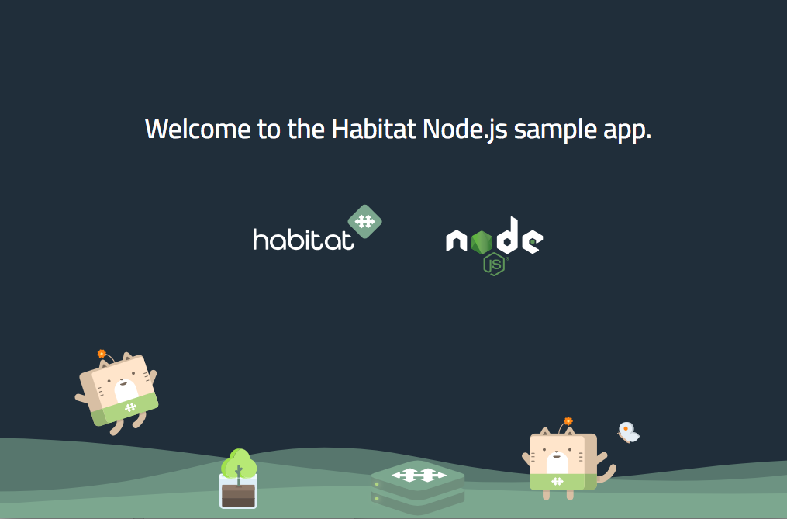
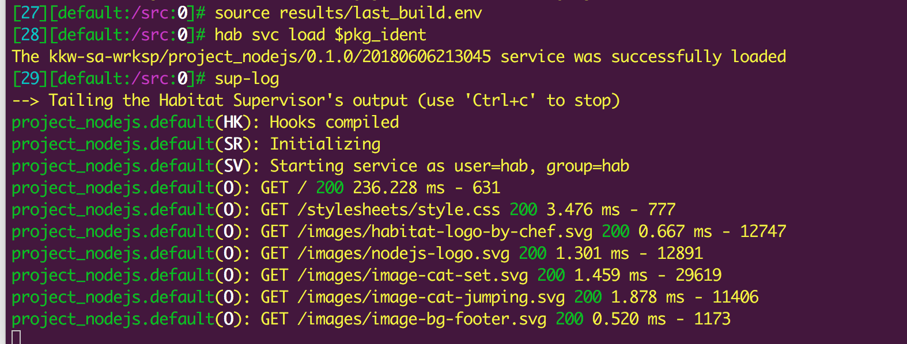
You just built and deployed an app with Habitat!!
GO TO →
http://YOUR_WORKSTATION_IP:8000
To see the supervisor output in Hab studio:
`sup-log`

Slide 42
Clean-up
Unload (i.e stop) the Hab services you are running in Hab Studio
[default:/src:0]# hab svc status
[default:/src:0]# hab svc unload <PACKAGENAME>
Ex
Example
[default:/src:0]# hab svc status
package type state uptime (s) pid group
scottford/project_nodejs/1.0.0/20180607202259 standalone up 262 10654 project_nodejs.default
[default:/src:0]# hab svc unload scottford/national-parks
Unloading scottford/project_nodejs/1.0.0/20180607202259

Slide 43
Section 4:
Project - Node.js + Docker
Export and run your Hab Package into Docker format

Slide 44
Export your Habitat Package to Docker format
[default:/src:0]# source results/last_build.env
[default:/src:0]# hab pkg export docker results/$pkg_artifact
[default:/src:0]# exit
hab pkg export docker <package name> - puts your Hab package into a Docker format
$pkg_artifact - Habitat is pulling the package name from the results of the last build

Slide 45
Run your Hab package in Docker (outside of studio)
$ sudo docker image ls
REPOSITORY TAG IMAGE ID CREATED SIZE
scottford/project_nodejs 0.1.0 bc287c46b3f6 20 minutes ago 331 MB
scottford/project_nodejs 0.1.0-20180611232247 bc287c46b3f6 20 minutes ago 331 MB
scottford/project_nodejs latest bc287c46b3f6 20 minutes ago 331 MB
$ source results/last_docker_export.env
$ sudo docker run -it -p 8000:8000 $name
hab-sup(MR): Supervisor Member-ID 4508f19af6514ff2830d3423688f4133
hab-sup(AG): The scottford/project_nodejs service was successfully loaded
hab-sup(MR): Starting scottford/project_nodejs
project_nodejs.default(UCW): Watching user.toml
hab-sup(MR): Starting gossip-listener on 0.0.0.0:9638
hab-sup(MR): Starting ctl-gateway on 127.0.0.1:9632

Slide 46
The Hab Package is now running in Docker!
GO TO →
http://YOUR_WORKSTATION_IP:8000
All the benefits of the standardized Hab build process into a otherwise totally regular Docker container.
+ Automatic updates with The Supervisor……(more on that later in the lab)

Slide 47
Section 4:
National Parks Application
Export and run your Hab Package into Docker format

Slide 48
Overview of National Parks App
We will be building this application iteratively and gradually adding functionality and Habitat concepts as we move forward!
MongoDB database that stores US national park data
Java/Tomcat application displays parks on a map
HAProxy load balances multiple instances of java app

Slide 49
Create a plan.sh for your application
$ cd ~/habitat_jumpstart/national-parks
$ hab plan init
» Attempting autodiscovery
No scaffolding type was provided. Let's see if we can figure out what
kind of application you're planning to package.
∅ Unable to determine the type of app in your current directory
For now, we'll generate a plan with all of the available plan variables
and build phase callbacks. For more documentation on plan options try
passing --withdocs or visit
https://www.habitat.sh/docs/reference/plan-syntax/
Scaffolding provides no assistance here!

Slide 50
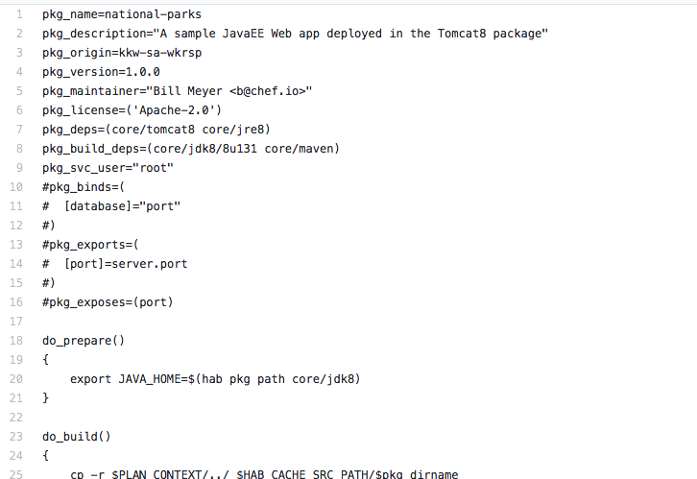
Update your plan.sh from a working example
$ nano habitat/plan.sh
Replace auto-generated plan.sh with the content of NP plan.sh v1
After copying contents into your plan.sh, set pkg_origin to the name of your Builder Origin

Slide 51
What is actually in the plan.sh now?
pkg_name=national-parks pkg_description="A sample JavaEE Web app deployed in the Tomcat8 package" pkg_origin= pkg_version=1.0.0 pkg_maintainer="Bill Meyer <b@chef.io>" pkg_license=('Apache-2.0') pkg_deps=(core/tomcat8 core/jre8) pkg_build_deps=(core/jdk8/8u131 core/maven) pkg_svc_user="root"
do_prepare(){ export JAVA_HOME=$(hab pkg path core/jdk8)}
do_build(){ cp -r $PLAN_CONTEXT/../ $HAB_CACHE_SRC_PATH/$pkg_dirname cd ${HAB_CACHE_SRC_PATH}/${pkg_dirname} mvn package} do_install(){ cp ${HAB_CACHE_SRC_PATH}/${pkg_dirname}/target/${pkg_name}.war ${PREFIX}/}

Slide 52
What are Lifecycle Hooks?
Lifecycle hooks define actions your application can take during runtime
Templated, so you can use configuration data provided at runtime
Start with #! to specify the interpreter to use
On Linux, this is usually Bash
On Windows, this is always powershell so #! can be omitted
Available Hooks
init | run | reconfigure | health_check | file_updated
post-stop | post-run | reload | suitability | smoke_check

Slide 53
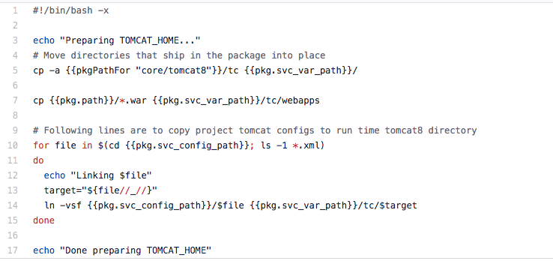
Create and add init hooks to your National Parks app
$ nano habitat/hooks/init
Content: NP hooks init v1

Slide 54
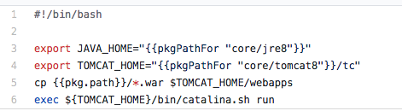
Create and add run hooks to your National Parks app
$ nano habitat/hooks/run
Content: NP hooks run v1

Slide 55
Setting Runtime Configurations with default.toml
habitat/default.toml provides the default values for your application to use
Can be overwritten to meet the needs of the environment
Namespaced based on type of information
cfg. - settings defined in default.toml
pkg. - details about the package currently running
sys. - information about the supervisor
svc. - information about the current services service group
bind. - information about service groups the service is bound to

Slide 56
Create and add default port values to default.toml
$ nano habitat/default.toml
Content for default.toml
[server] port = "8080" shutdown-port = "8005" redirect-port = "8443"
Notes:
Lets also talk about sup-log to view the supervisor output and why we had to use “hab pkg binlink” for curl. Good to mention how we could have used “hab pkg exec” instead.

Slide 57
Build and export your app from Hab Studio
~/habitat_jumpstart/national-parks
$ hab studio enter
[1][default:/src:0]# build
[1][default:/src:0]# source results/last_build.env
[1][default:/src:0]# hab pkg export docker results/$pkg_artifact
[1][default:/src:0]# exit
$ source results/last_docker_export.env
$ sudo docker run -it -p 8080:8080 $name
Make sure you are in the “national-parks” sub directory when you start up Hab Studio
Notes:
There are no national parks!...yet

Slide 58
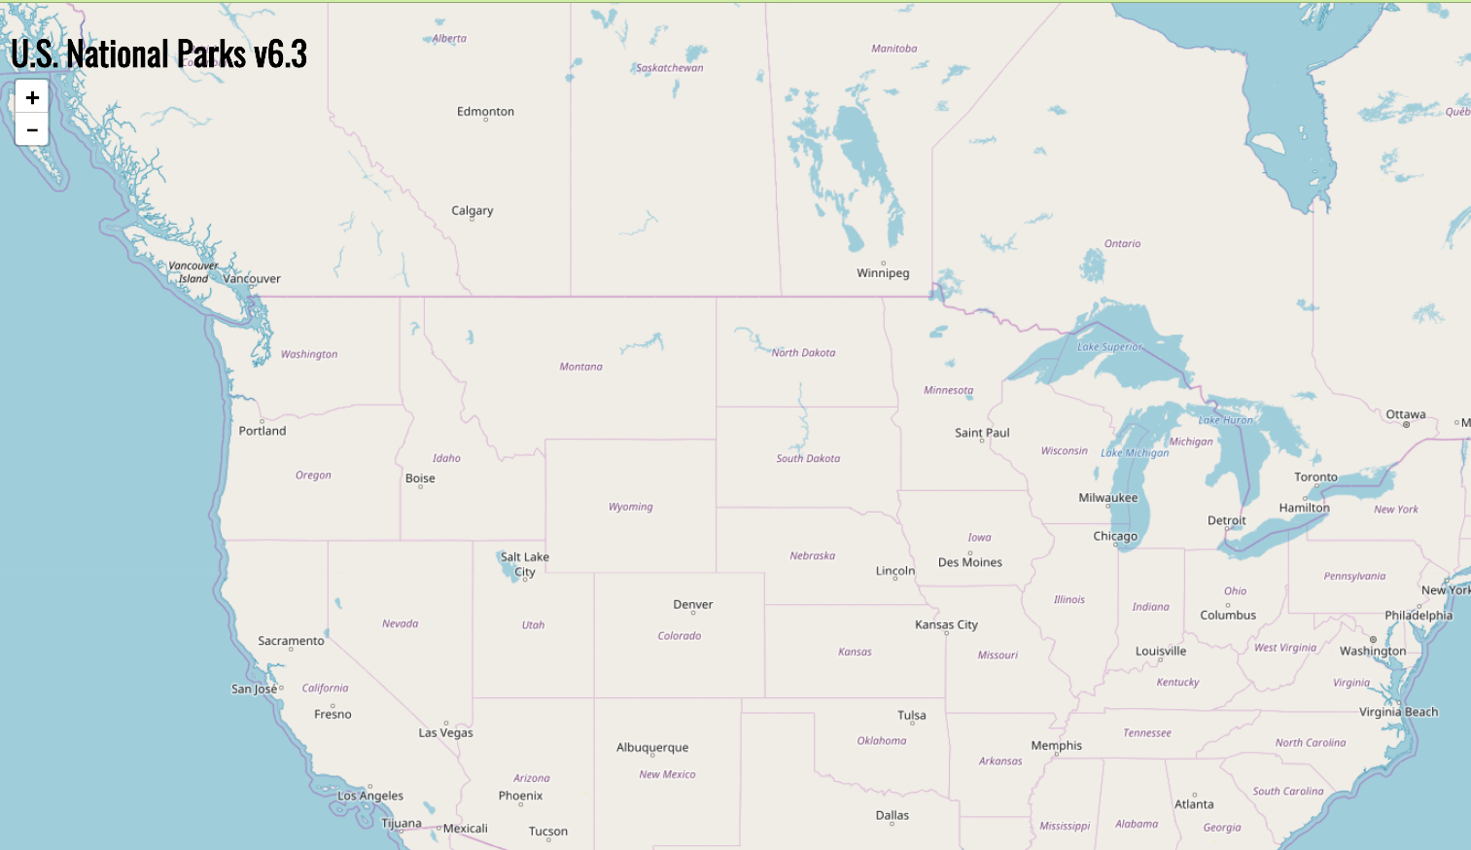
Your Hab package is deployed…..
GO TO → http://YOUR_WORKSTATION_IP:8080/national-parks/
Nice Map. Where are the parks?

Slide 59
Section 5:
Binding
That app needs to talk to a DB to work properly

Slide 60
Binding
Binding is how services discover and interact with each other in a Supervisor Ring
Binds are implemented via a “contract” between a “consumer” plan and a “provider” plan
The Habitat Supervisor will start a service only after all required binds are present
Notes:
There are no national parks!...yet

Slide 61
Binding for Consumers (Build-Time)
Consumer requirements expressed via “pkg_binds” and/or “pkg_binds_optional”
pkg_binds=( [database]="port" )
Notes:
There are no national parks!...yet

Slide 62
Binding for Providers (Build-Time)
Providers advertise what is provided via “pkg_exports”
pkg_exports=( [port]=server.port )
Notes:
There are no national parks!...yet

Slide 63
Binding at Run-Time
The “--bind” argument specifies the actual provider service to bind to when starting a consumer service:
$ hab svc load mwrock/national-parks --bind database:mongodb.default
(^^ For display purposes only, don’t run this)
Notes:
There are no national parks!...yet

Slide 64
Modify your Habitat package to bind to a mongoDB
plan.sh
init & run hooks
default.toml
mongo.toml

Slide 65
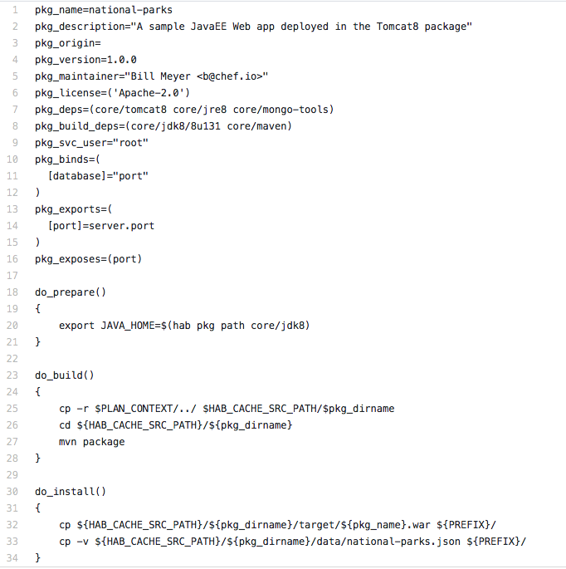
Edit the plan.sh to add bind settings for the DB
$ nano habitat/plan.sh
Update plan.sh
National Parks plan.sh v2 with bindings
Add mongo-tools to dependencies
Uncomment lines to add DB binds and port exports
Copy the park data in the do_install()

Slide 66
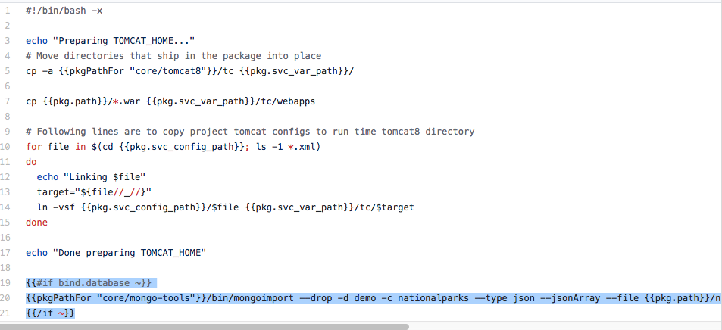
Edit init hooks to work with data binding
Add content to your hooks file: init hook v2 with bindings
Append last 3 lines to your file to define the binding

Slide 67
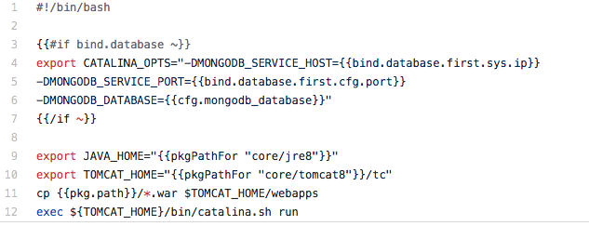
Edit run hooks to work with data binding
Add content: run hook v2 with bindings
Add the {#if bind.database}
section

Slide 68
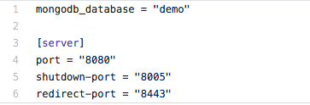
Update default.toml with a default DB name
Update Content: default.toml
Add mongodb_database to the top of the file

Slide 69
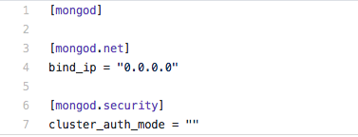
Create and add mongo.toml to habitat folder
$ nano habitat/mongo.toml
Content : mongo.toml

Slide 70
Build and run your Hab package (new and improved with DB bindings) in Hab Studio
~/habitat_jumpstart/national-parks
$ hab studio enter
[default:/src:0]# build
national-parks: I love it when a plan.sh comes together.
national-parks:
national-parks: Build time: 0m8s
[default:/src:0]# source results/last_build.env
[default:/src:0]# hab svc load core/mongodb/3.2.10/20171101045425
[default:/src:0]# hab config apply mongodb.default $(date +%s) habitat/mongo.toml
[default:/src:0]# hab svc load $pkg_ident --bind database:mongodb.default
Loading a core Mongo DB package
Applying our defined configurations to the running MongoDB service
Loading and Binding NP package to the default port for the MongoDB database

Slide 71
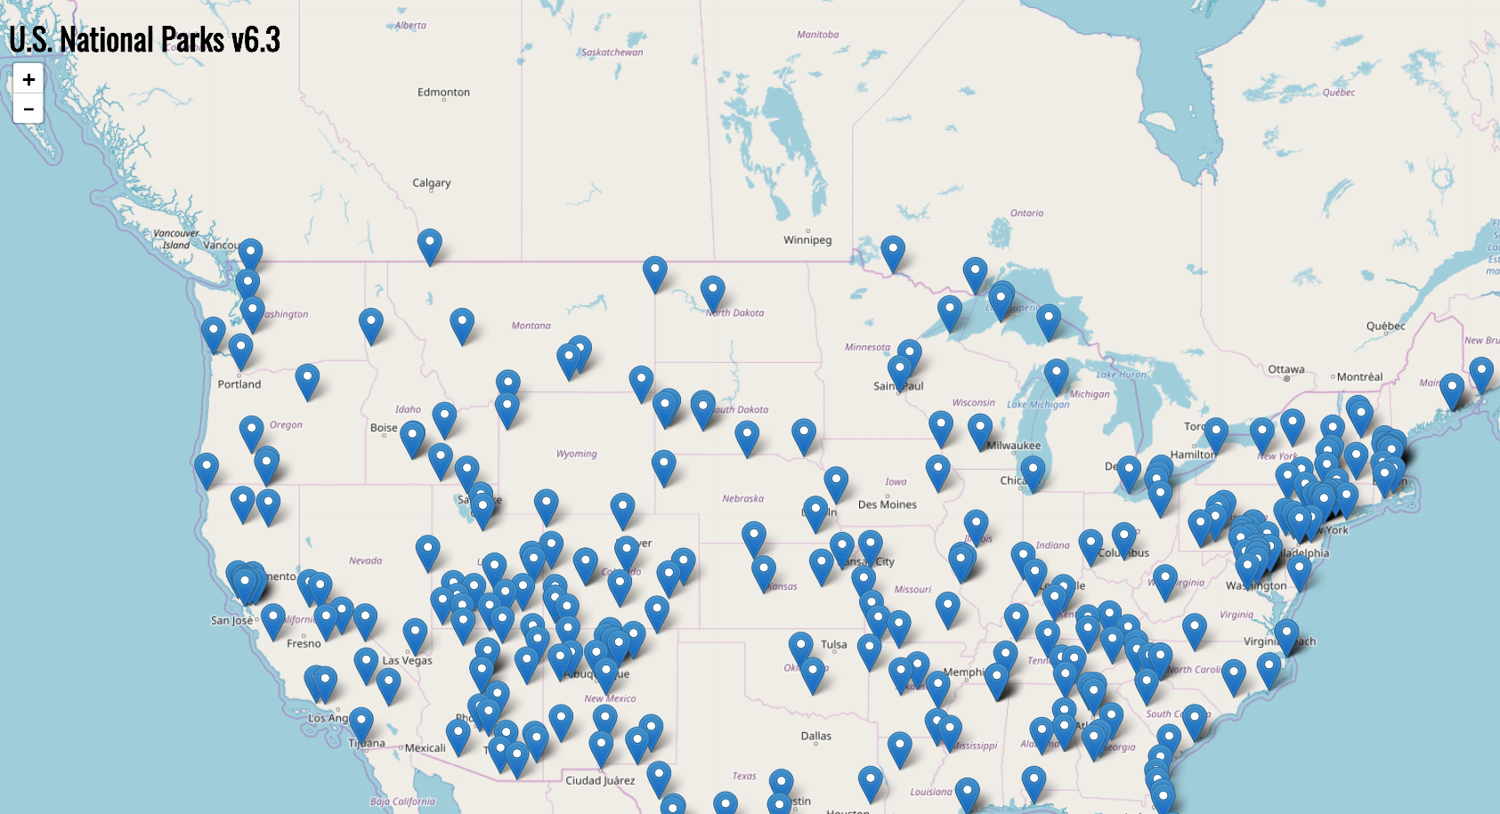
GO TO → http://YOUR_WORKSTATION_IP:8080/national-parks/
Its full of parks!!

Slide 72
Clean-up
Unload (i.e stop) the Hab services you are running in Hab Studio
[default:/src:0]# hab svc status
[default:/src:0]# hab svc unload <PACKAGENAME>
Ex
Example
[default:/src:0]# hab svc status
package type state uptime (s) pid group
core/mongodb/3.2.10/20171016003652 standalone up 264 10620 mongodb.default
scottford/national-parks/1.0.0/20180607202259 standalone up 262 10654 national-parks.default
[default:/src:0]# hab svc unload scottford/national-parks
Unloading scottford/national-parks/1.0.0/20180607202259
[default:/src:0]# hab svc unload core/mongodb
Unloading core/mongodb/3.2.10/20171016003652

Slide 73
Section 6:
Binding across supervisors
O
1 DB
3 Tomcat Servers
One Supervisor ring to bind them all

Slide 74
The pkg_exports and pkg_exposes in the plan.sh
This has already been uncommented in your plan.sh file (yay!)
pkg_exports=( [port]=server.port ) pkg_exposes=(port)
Remember: pkg_exports expresses the provider side of the binding contract. Now our java app is going to make configuration available to a consumer (haproxy).
pkg_exposes - Exposes ports in exported docker containers

Slide 75
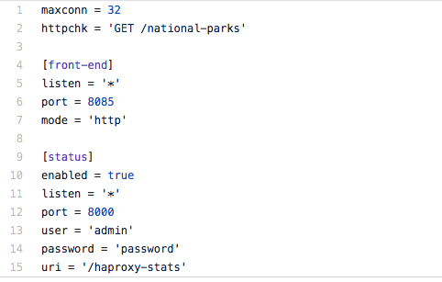
Create the haproxy.toml file
$ nano habitat/haproxy.toml
Content: haproxy.toml

Slide 76
Build your app and export all services into containers
$ hab studio enter
[default:/src:0]# build
national-parks: I love it when a plan.sh comes together.
[default:/src:0]# source results/last_build.env
[default:/src:0]# hab pkg export docker core/mongodb/3.2.10/20171101045425
[default:/src:0]# hab pkg export docker core/haproxy
[default:/src:0]# hab pkg export docker results/$pkg_artifact
[default:/src:0]# exit

Slide 77
Start and configure mongodb (outside of Studio)
$ source results/last_build.env
$ source results/last_docker_export.env
$ sudo hab sup run &
$ sudo docker run -d core/mongodb --peer <PRIVATE_WORKSTATION_IP>
$ sudo hab config apply mongodb.default $(date +%s) habitat/mongo.toml
Result: mongoDB Hab package running in a container on port 9638
Note: PRIVATE_WORKSTATION_IP is the IP in the 10.0.1.x format

Slide 78
Start 3 containers running Tomcat app (outside Studio)
Open 3 new SSH consoles / windows and repeat the following in each:
$ cd habitat_jumpstart/national-parks/
$ source results/last_docker_export.env
$ mongo_id=$(sudo docker ps -qf "ancestor=core/mongodb")
$ mongo_ip=$(sudo docker inspect -f '{{range .NetworkSettings.Networks}}{{.IPAddress}}{{end}}' $mongo_id)
$ sudo docker run -it $name --bind database:mongodb.default --peer <PRIVATE_WORKSTATION_IP> --strategy rolling --topology leader
--strategy defines how supervisors relate to one another
Notes:
Note how the services do not start until quorum is established

Slide 79
Start and configure haproxy (outside of Studio)
Open one more SSH session and execute the following:
$ cd habitat_jumpstart/national-parks/
$ source results/last_docker_export.env
$ sudo docker run -d -p 8085:8085 -p 8000:8000 core/haproxy --bind backend:national-parks.default --peer <PRIVATE_WORKSTATION_IP>
$ sudo hab config apply haproxy.default $(date +%s) habitat/haproxy.toml
Result: haproxy Hab package running in a container on port 8000

Slide 80
Celebrate that you have deployed a balanced app managed by a Hab Supervisor Ring!
Point your browser to http://<public ip>:8085/national-parks/ and you should now see the app balanced across 3 containers!
Now browse to http://<public ip>:8000/haproxy-stats and use “admin” and “password” as username and password. This shows the app containers binding with haproxy.
Add another national-parks container and watch the backend pool grow!

Slide 81
Section 7:
Deploy new changes to your locally running Hab app
O

Slide 82
Update your running National Parks Hab app
Change the pkg_version in your plan.sh to any version greater than what it is currently set to. (i.e 6.3.2)
Update the <h1> title in src/main/webapp/index.html
Do a local build
Promote the package into the Stable channel
Refresh your browser pointed to http://<public ip>:8085/national-parks/ and you should see an updated version within 60 seconds!
$ export HAB_AUTH_TOKEN=<Your Builder Personal Access Token>
$ hab studio enter
[default:/src:0]# build
[default:/src:0]# source results/last_build.env
[default:/src:0]# hab pkg upload results/$pkg_artifact
[default:/src:0]# hab pkg promote $pkg_ident stable

Slide 83
Section 8:
How to associating your local app with the Public Builder
(i.e. more 1-time admin setup)
O

Slide 84
Hab Studio is great, why bother with Builder?
A hosted build service for building Habitat plans
Can connect to your GitHub plan repository
Notified as new code is pushd and performs a build
A Docker account can be associated and a docker image will be exported and sent to that account

Slide 85
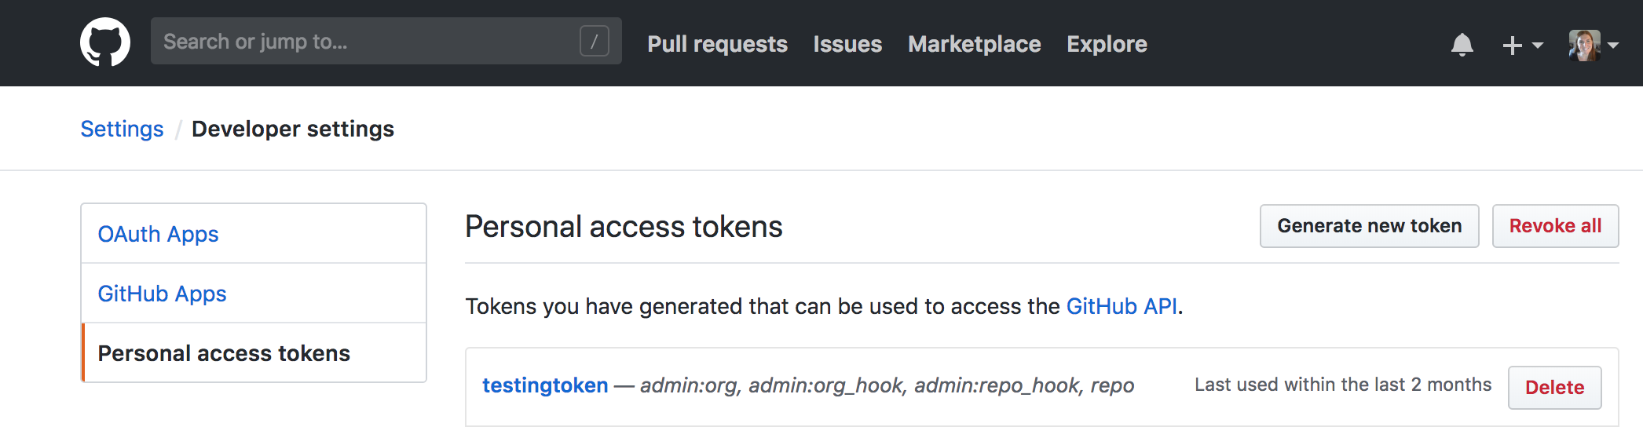
Generate New Github Token for Builder
Log into your GitHub account
Go to → https://github.com/settings/tokens
In Developer Settings select “Personal Access Tokens”

Slide 86
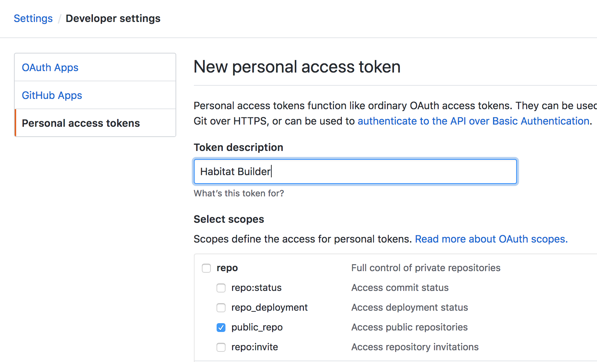
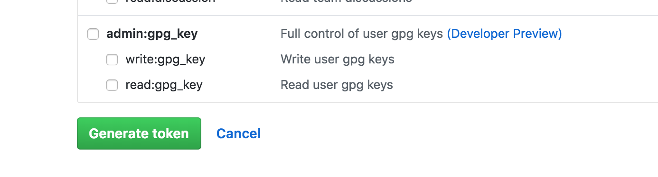
2. Assign scopes to the token (and a description)
Select
Repo, public_repo
User, user:email
Admin:org, read:org
Then scroll to the bottom of the page →

Slide 87
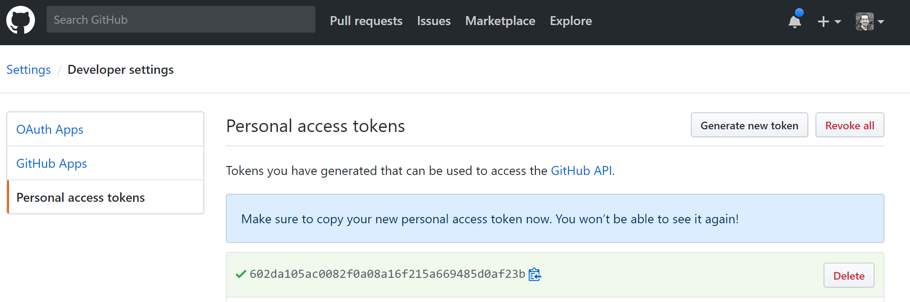
3. Copy generated token to a clipboard

Slide 88
4. Commit your updates to your fork and push to master
$ git remote -v
origin https://github.com/<YOUR GITHUB</habitat_jumpstart.git (fetch)
origin https://github.com/<YOUR GITHUB>/habitat_jumpstart.git (push)
$ git add .
$ git commit -am "my workshop updates"
$ git push origin master
Username for 'https://github.com':
You will be prompted for git credentials. Paste your copied token when prompted for a password.

Slide 89
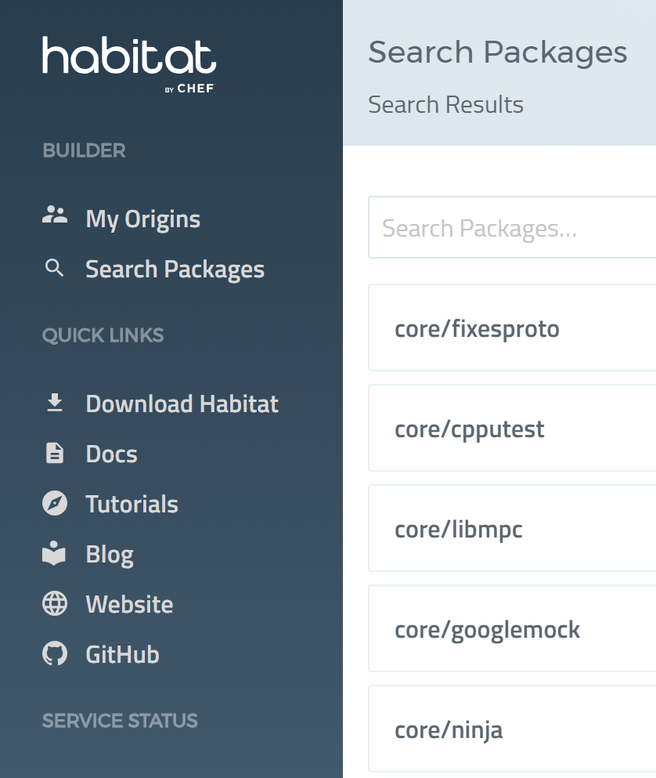
5. Log back into Habitat Builder
https://bldr.habitat.sh/#/origins
Click on the My Origins
Select the origin you created earlier in the day

Slide 90
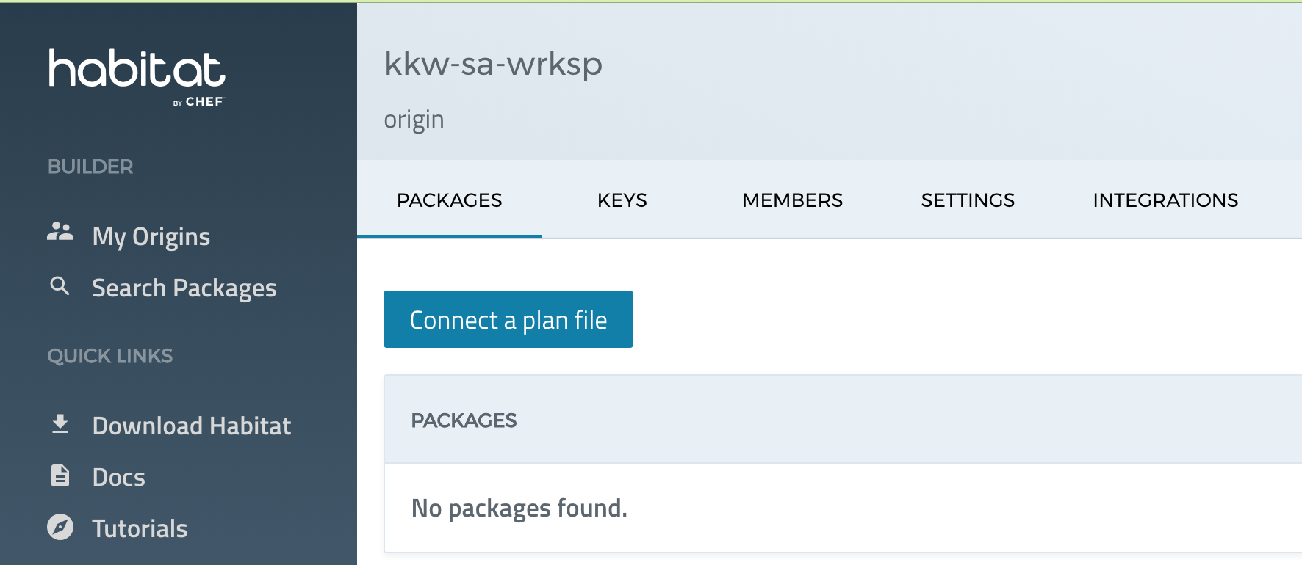
6. Select “Connect a Plan File”

Slide 91
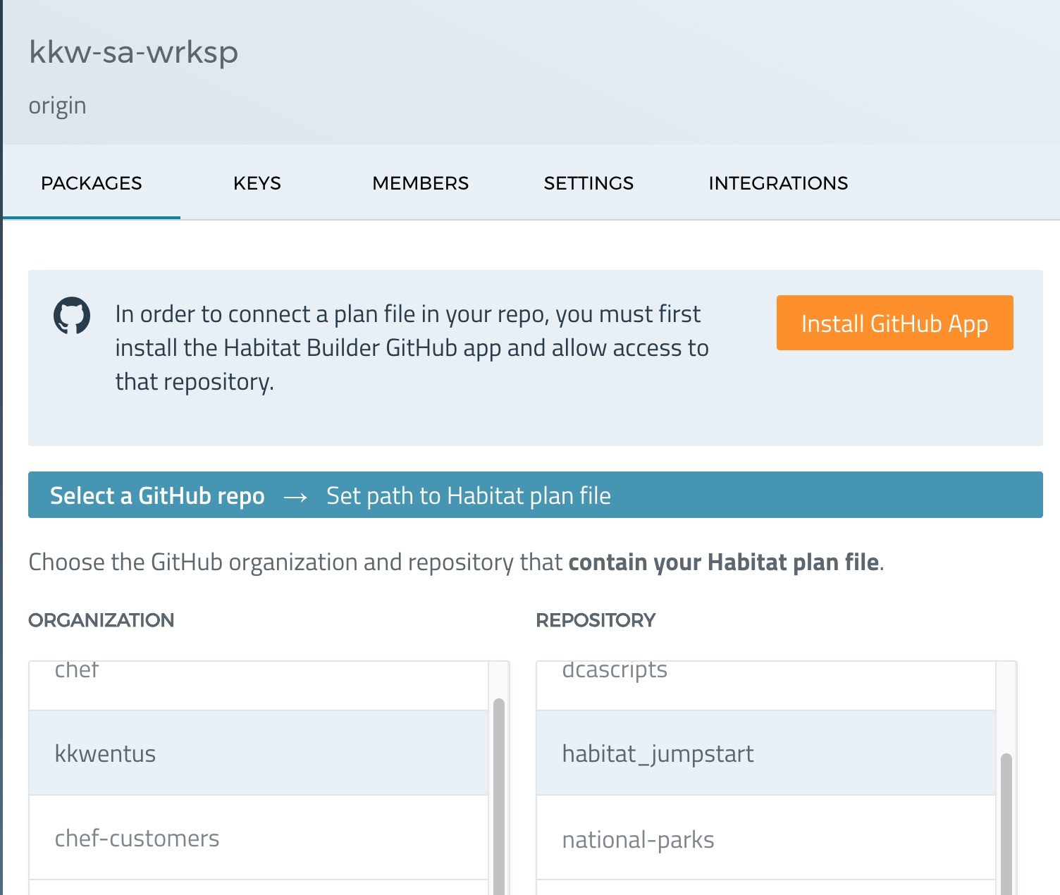
7. Select Install Github Application
FIRST click “Install Github App” button

Slide 92
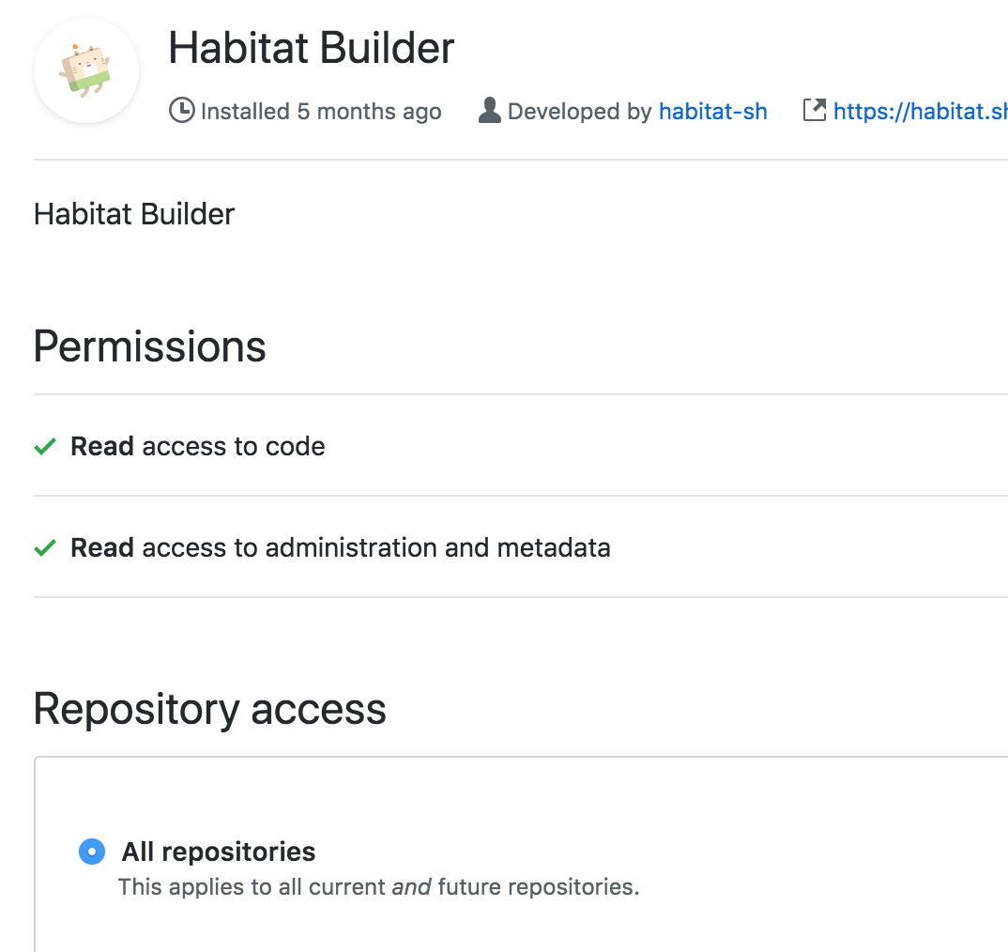
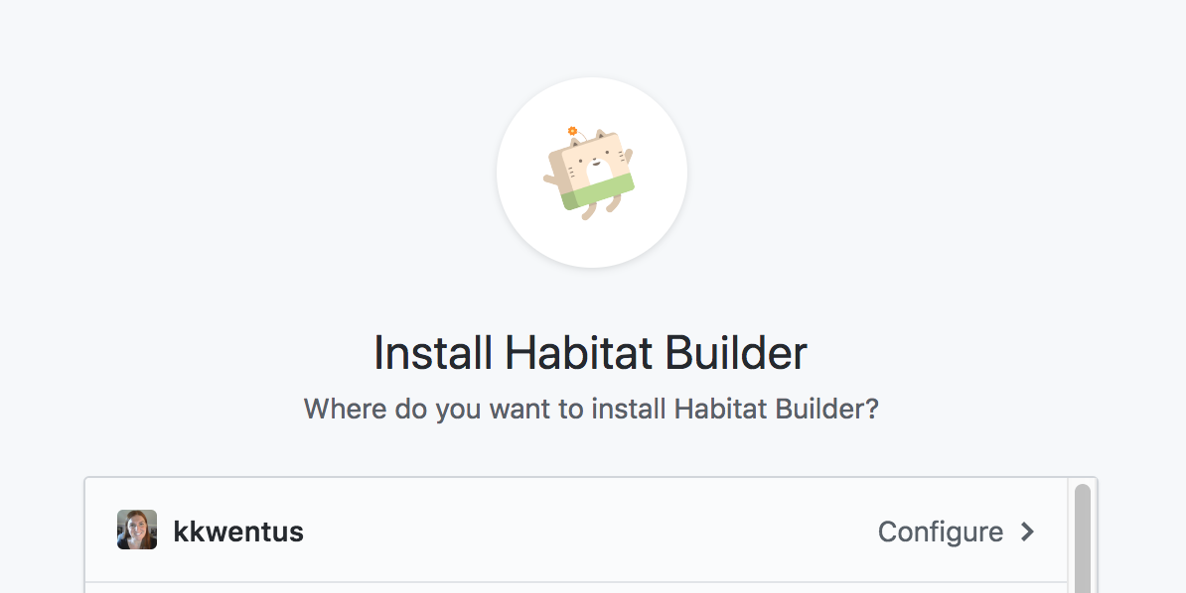
8. Configure to give permissions for your organization and the repos you desire
Select ALL REPOSITORIES →

Slide 93
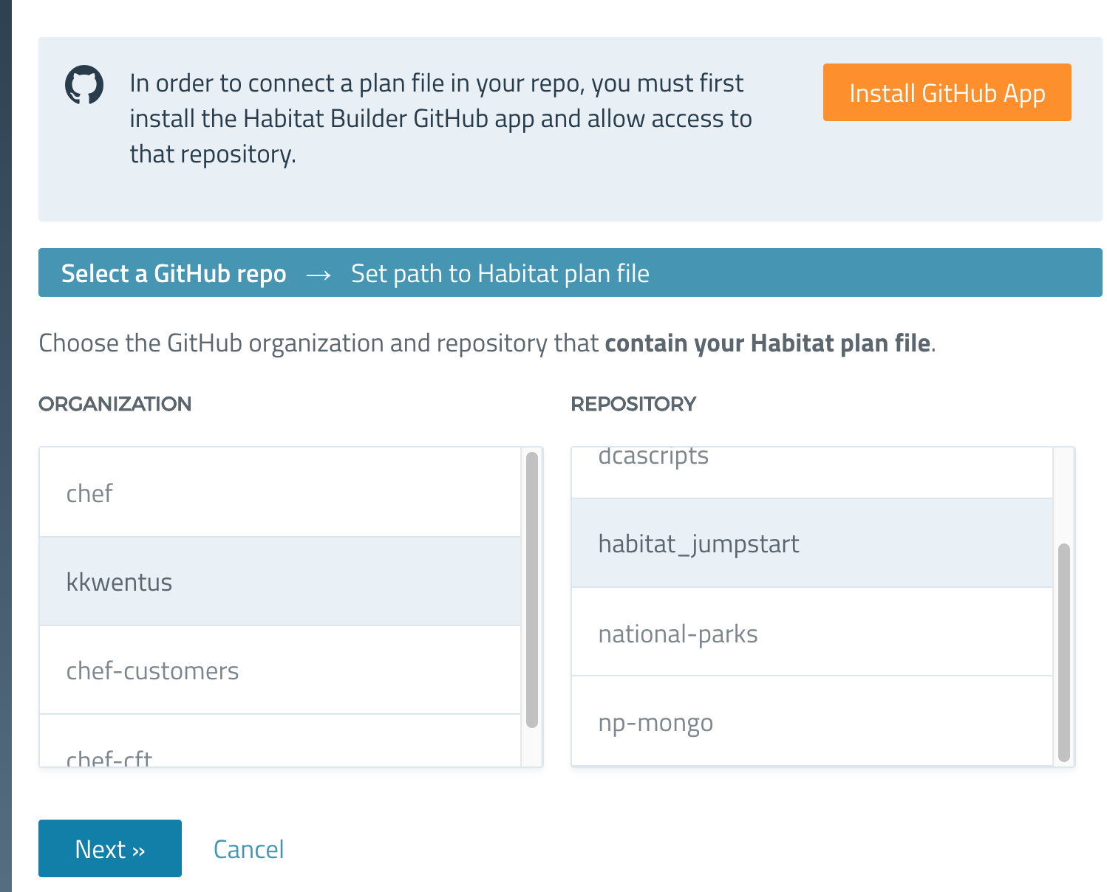
9. Go back to Hab Builder /Origin/Connect Plan
Now select the habitat_jumpstart repo you want to connect to builder
Note: the “Install Github App” button will still be there, even though you have done that step.

Slide 94
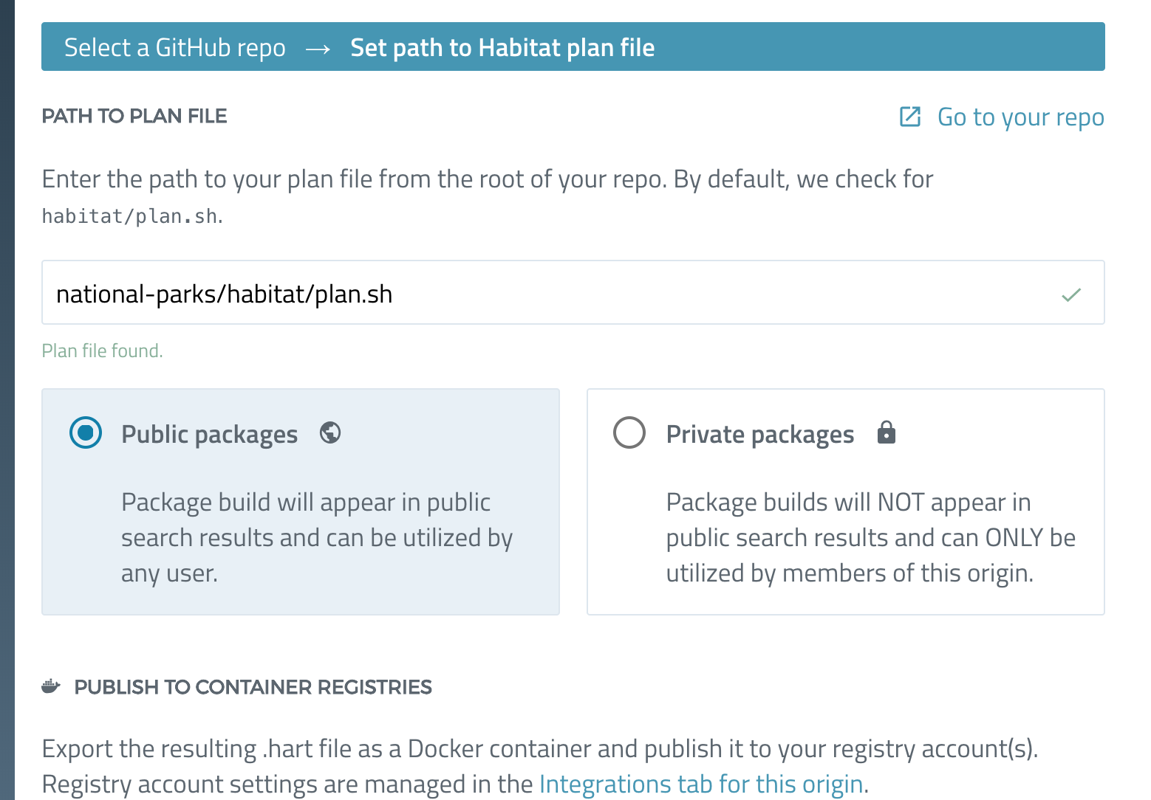
10. Select the path in your repo for the ‘plan.sh’
Set to national-parks/habitat/plan.sh

Slide 95
Section 9:
Trigger an automatic Hab build with a feature branch
O

Slide 96
Habitat loves change.
Wouldn’t it be nice if you could have continuous deployment to your Hab packages when you make changes to your code??
Or if a dependency changed, all the hab packages that used that dependency would get updated?
GOOD NEWS YOU CAN TOTALLY DO THAT!!!

Slide 97
Habitat loves change.
Now that we have connected our plan to Builder, and linked it to our GitHub repo,
whenever we commit a feature branch we can trigger a new build into already deployed Habitat environments
So lets do this.

Slide 98
Run the current configuration locally (so we can see the update later)
[default:/src:0]# hab svc load core/mongodb/3.2.10/20171101045425
[default:/src:0]# hab config apply mongodb.default $(date +%s) habitat/mongo.toml
[default:/src:0]# hab svc load <YOURORIGIN>/national-parks --bind database:mongodb.default --channel stable --strategy at-once

Slide 99
Lets make a small change to our NP app and see it get automatically consumed
Create a feature branch
[default:/src:0]# exit
$ cd ~/habitat_jumpstart/national-parks
$ git checkout -b <NAMEOFYOURBRANCH>

Slide 100
2. Bump the minor version of the pkg by editing habitat/plan.sh
~/habitat_jumpstart/national-parks
$ nano habitat/plan.sh
pkg_name=national-parks
pkg_description="A sample JavaEE Web app deployed in the Tomcat8 package"
pkg_origin=<YOUR ORIGIN>
pkg_version=6.4.0
...

Slide 101
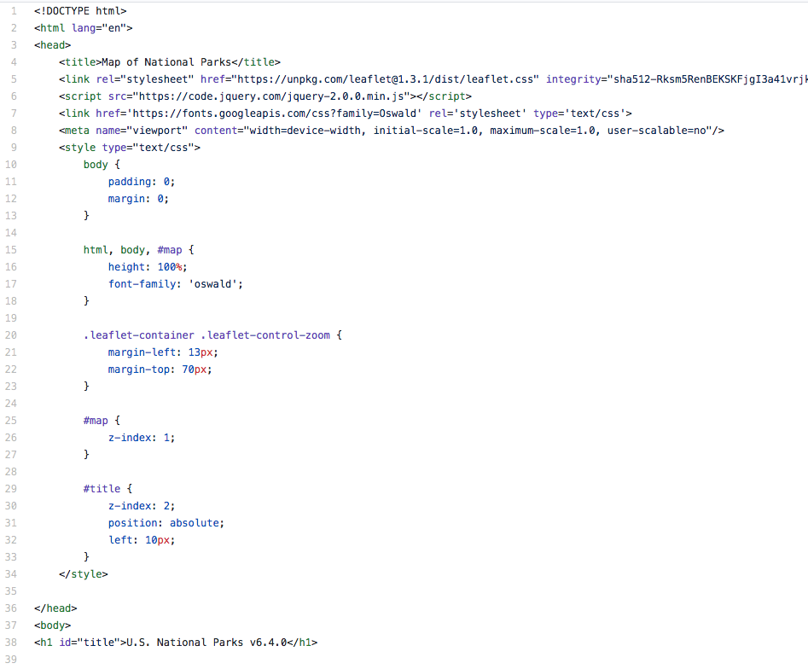
3. REPLACE all the contents in src/main/webapp/index.html
~/habitat_jumpstart/national-parks
$ nano src/main/webapp/index.html
Contents:
NP src main webapp index.html
This updated file will change your park icons to Red

Slide 102
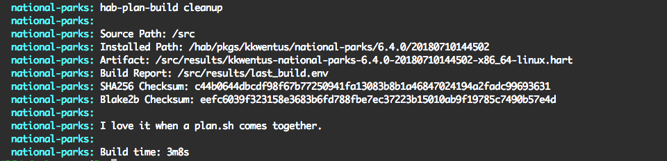
4. Enter Hab studio and Build, confirm no build errors
~/habitat_jumpstart/national-parks
$ hab studio enter [default:/src:0]# build

Slide 103
5. Add updated files to staging area and commit work
[default:/src:0]# exit
~/habitat_jumpstart/national-parks
$ git status
On branch update-map
Changes not staged for commit:
(use "git add <file>..." to update what will be committed)
(use "git checkout -- <file>..." to discard changes in working directory)
modified: src/main/webapp/index.html
$ git add .
$ git commit -m 'updates homepage with new icons and colored map'

Slide 104
6. Push branch to your repo
~/habitat_jumpstart/national-parks
$ git push origin <NAMEOFYOURBRANCH>
Counting objects: 86, done.
Delta compression using up to 4 threads.
Compressing objects: 100% (81/81), done.
Writing objects: 100% (86/86), 90.92 KiB | 4.13 MiB/s, done.
Total 86 (delta 44), reused 0 (delta 0)
remote: Resolving deltas: 100% (44/44), completed with 10 local objects.
To https://github.com/smford22/national-parks.git
* [new branch] update-map -> update-map

Slide 105
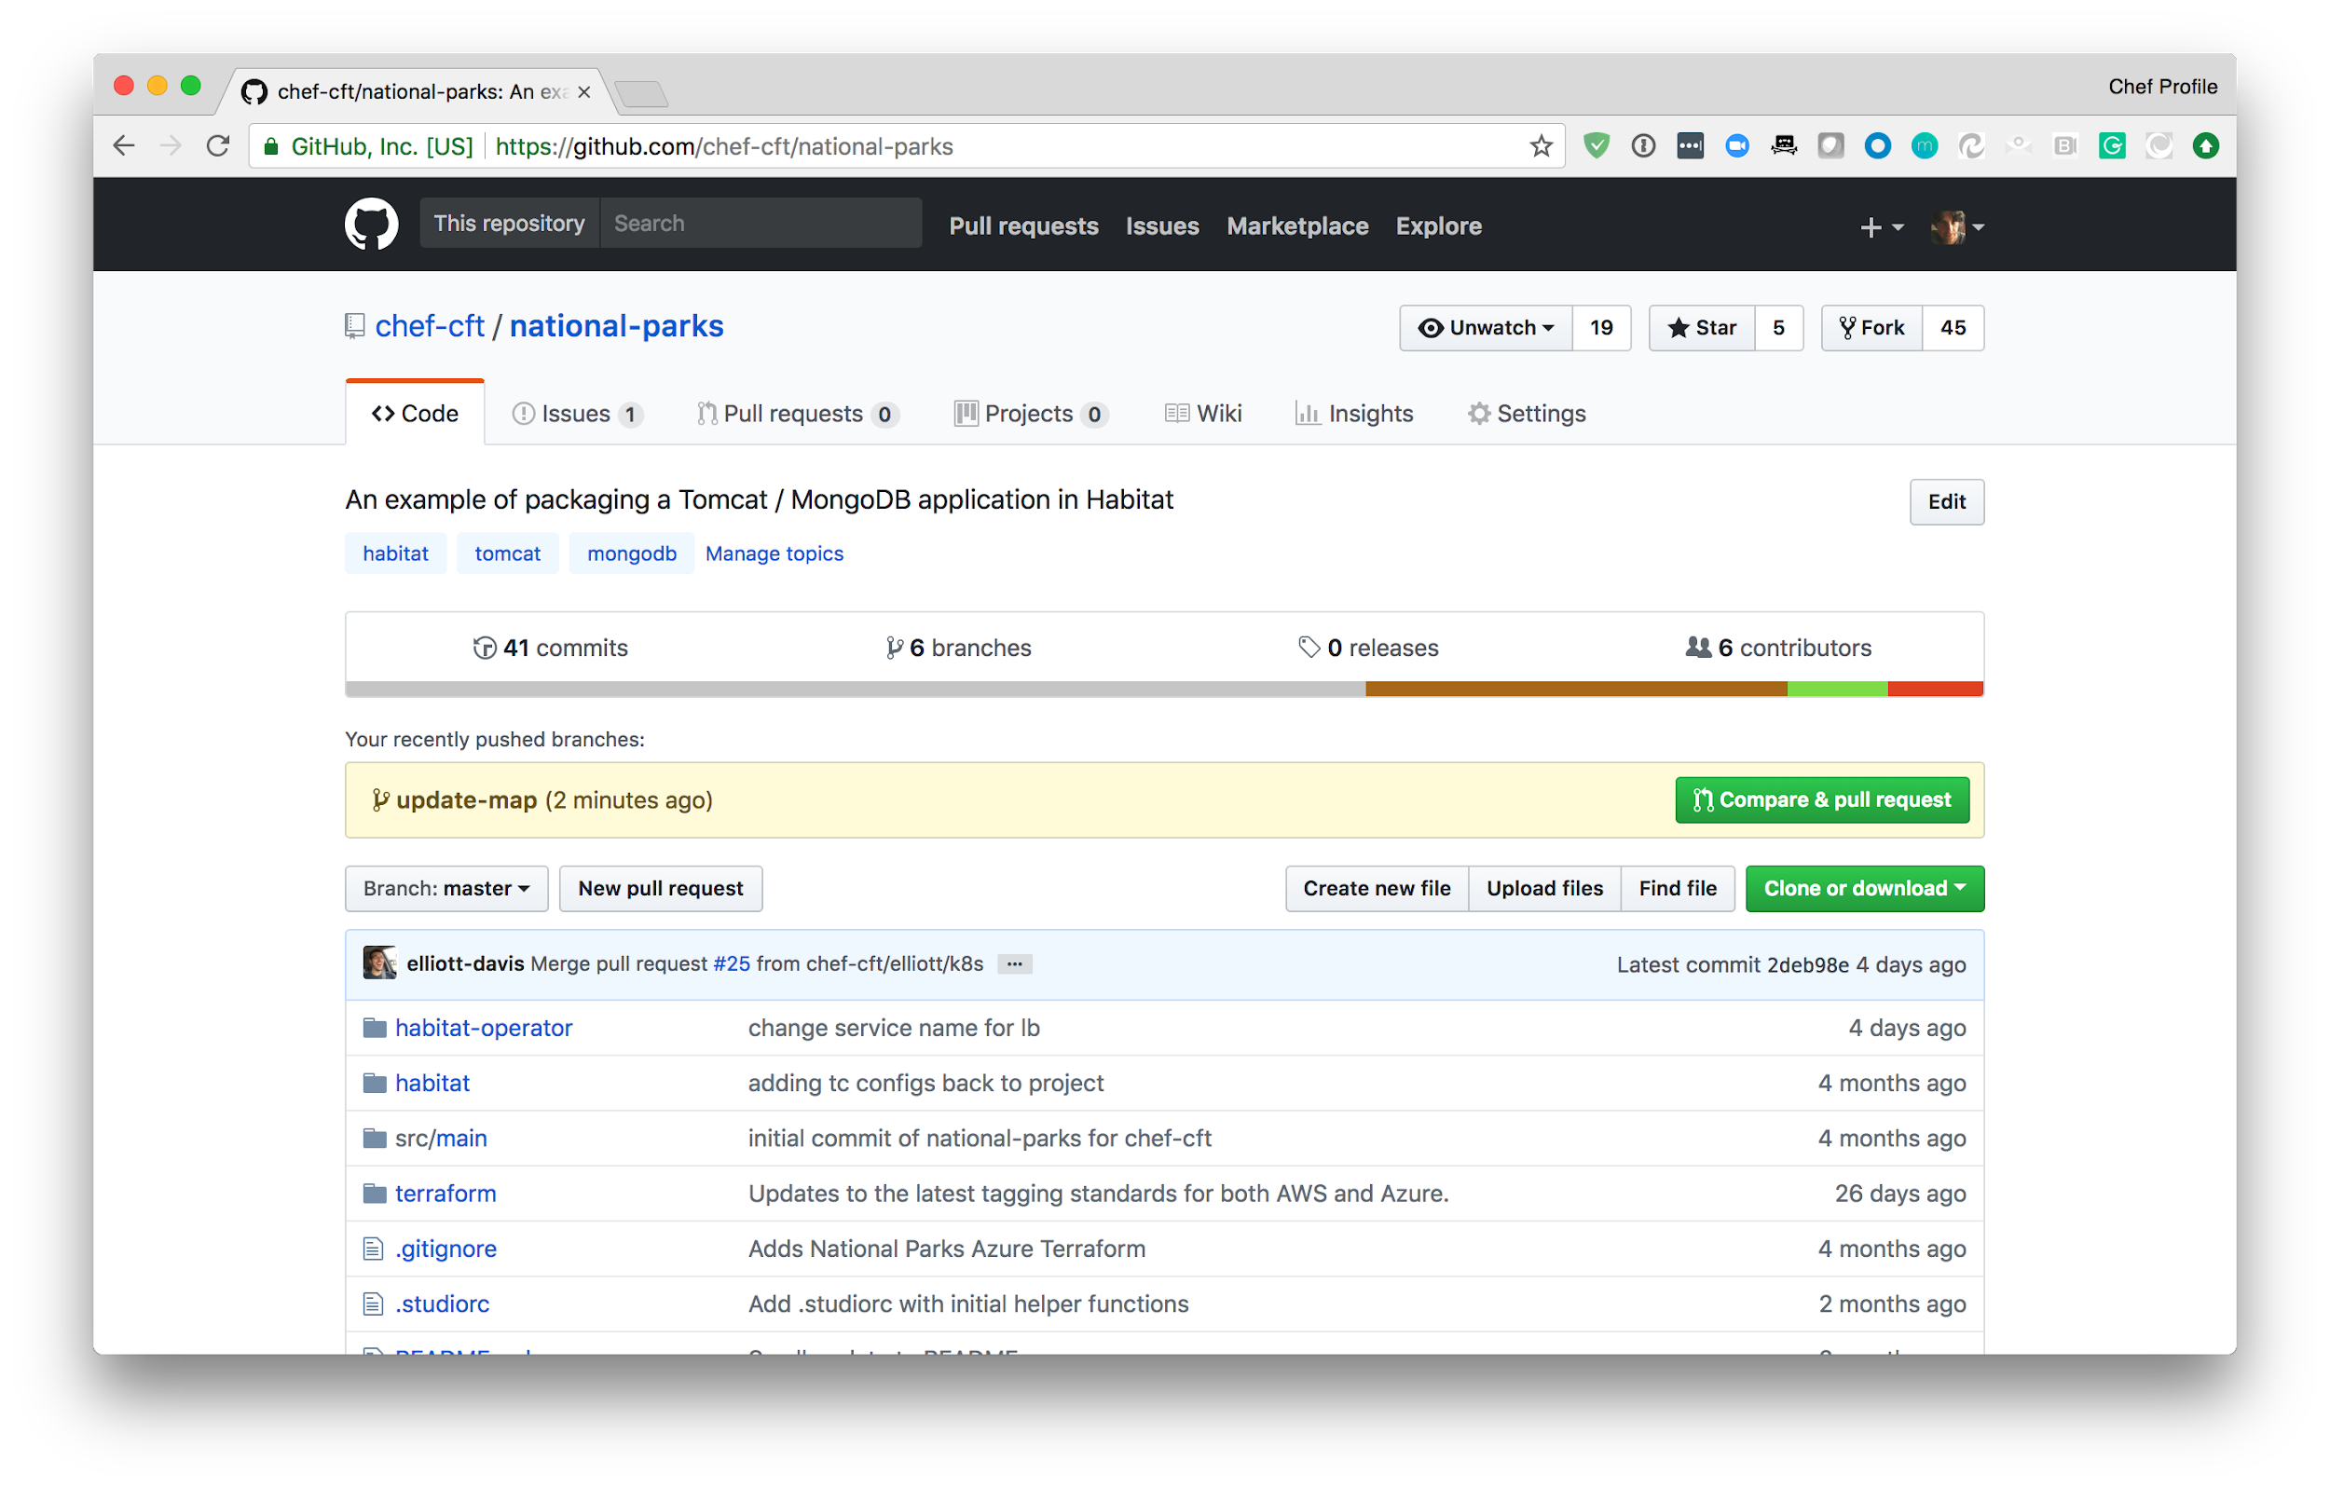
7. GitHub: Create PR
← Click ‘Compare & pull request’

Slide 106
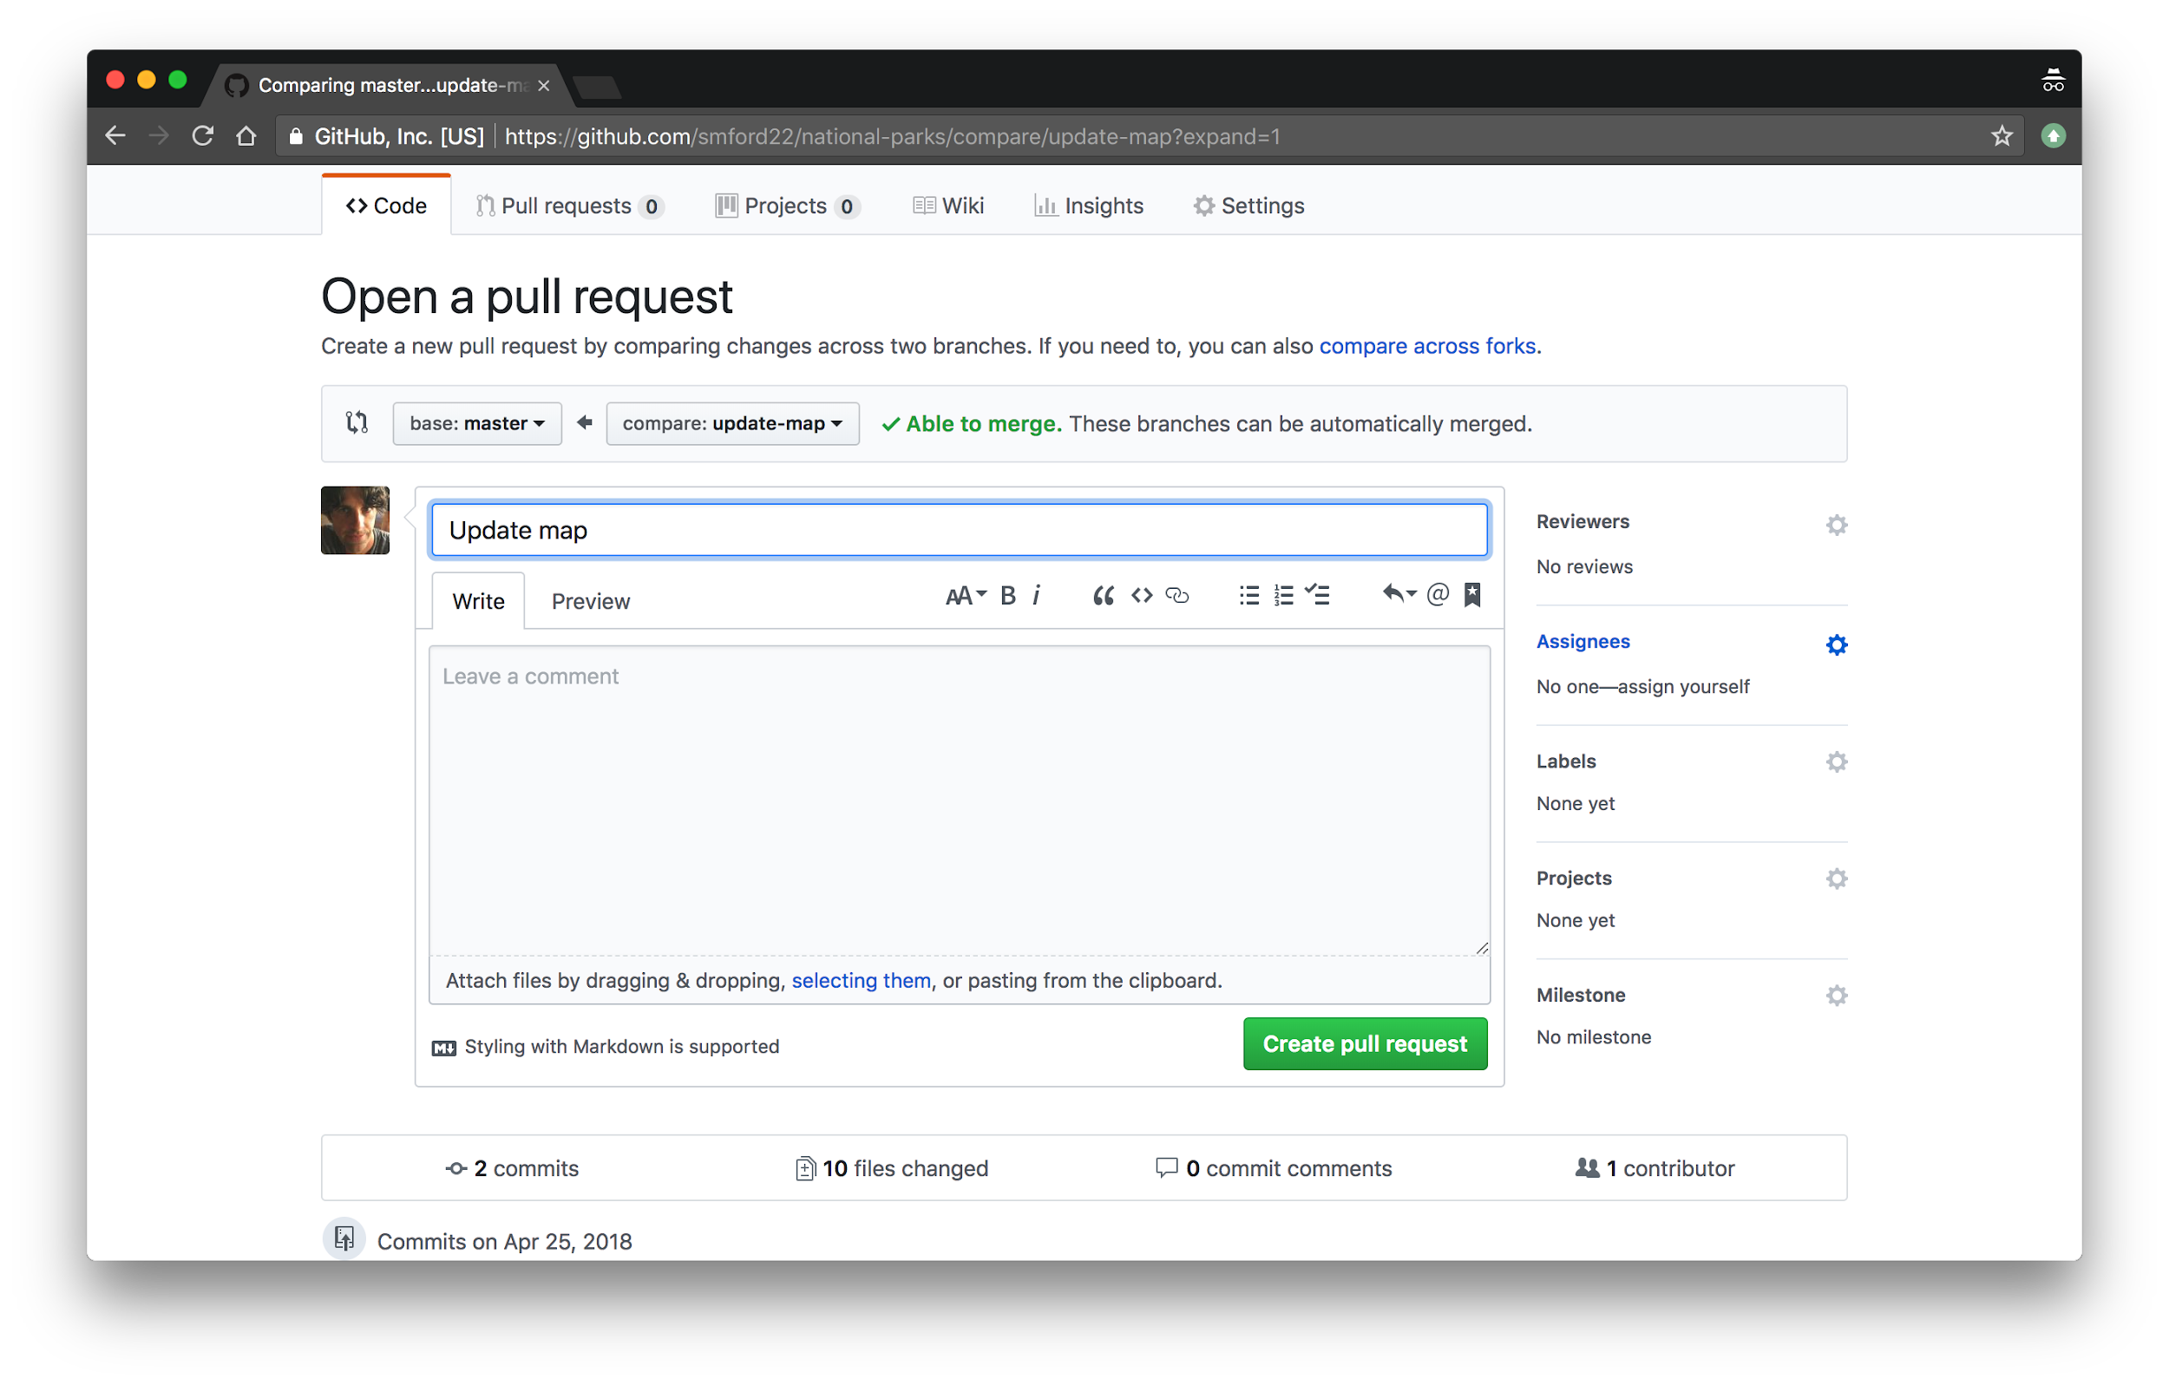
7. GitHub: Create PR, ctnd

Slide 107
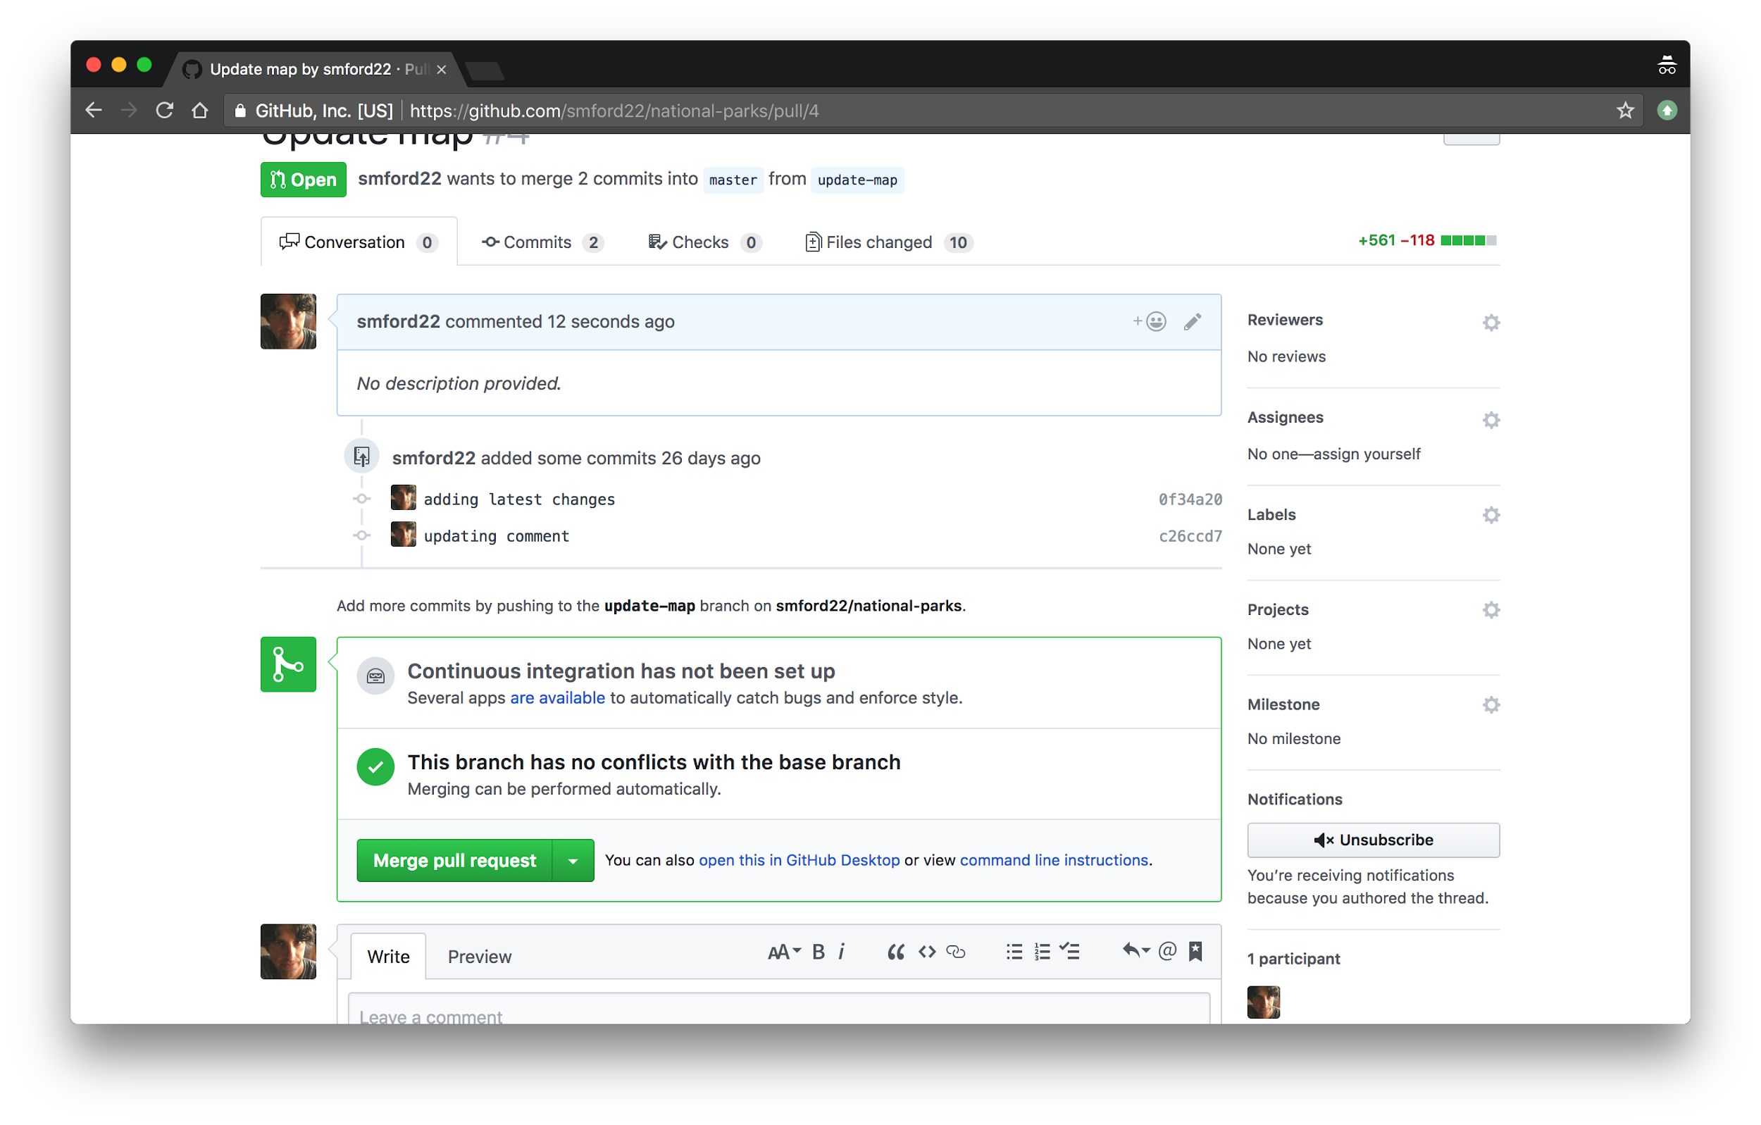
8. GitHub: Merge PR

Slide 108
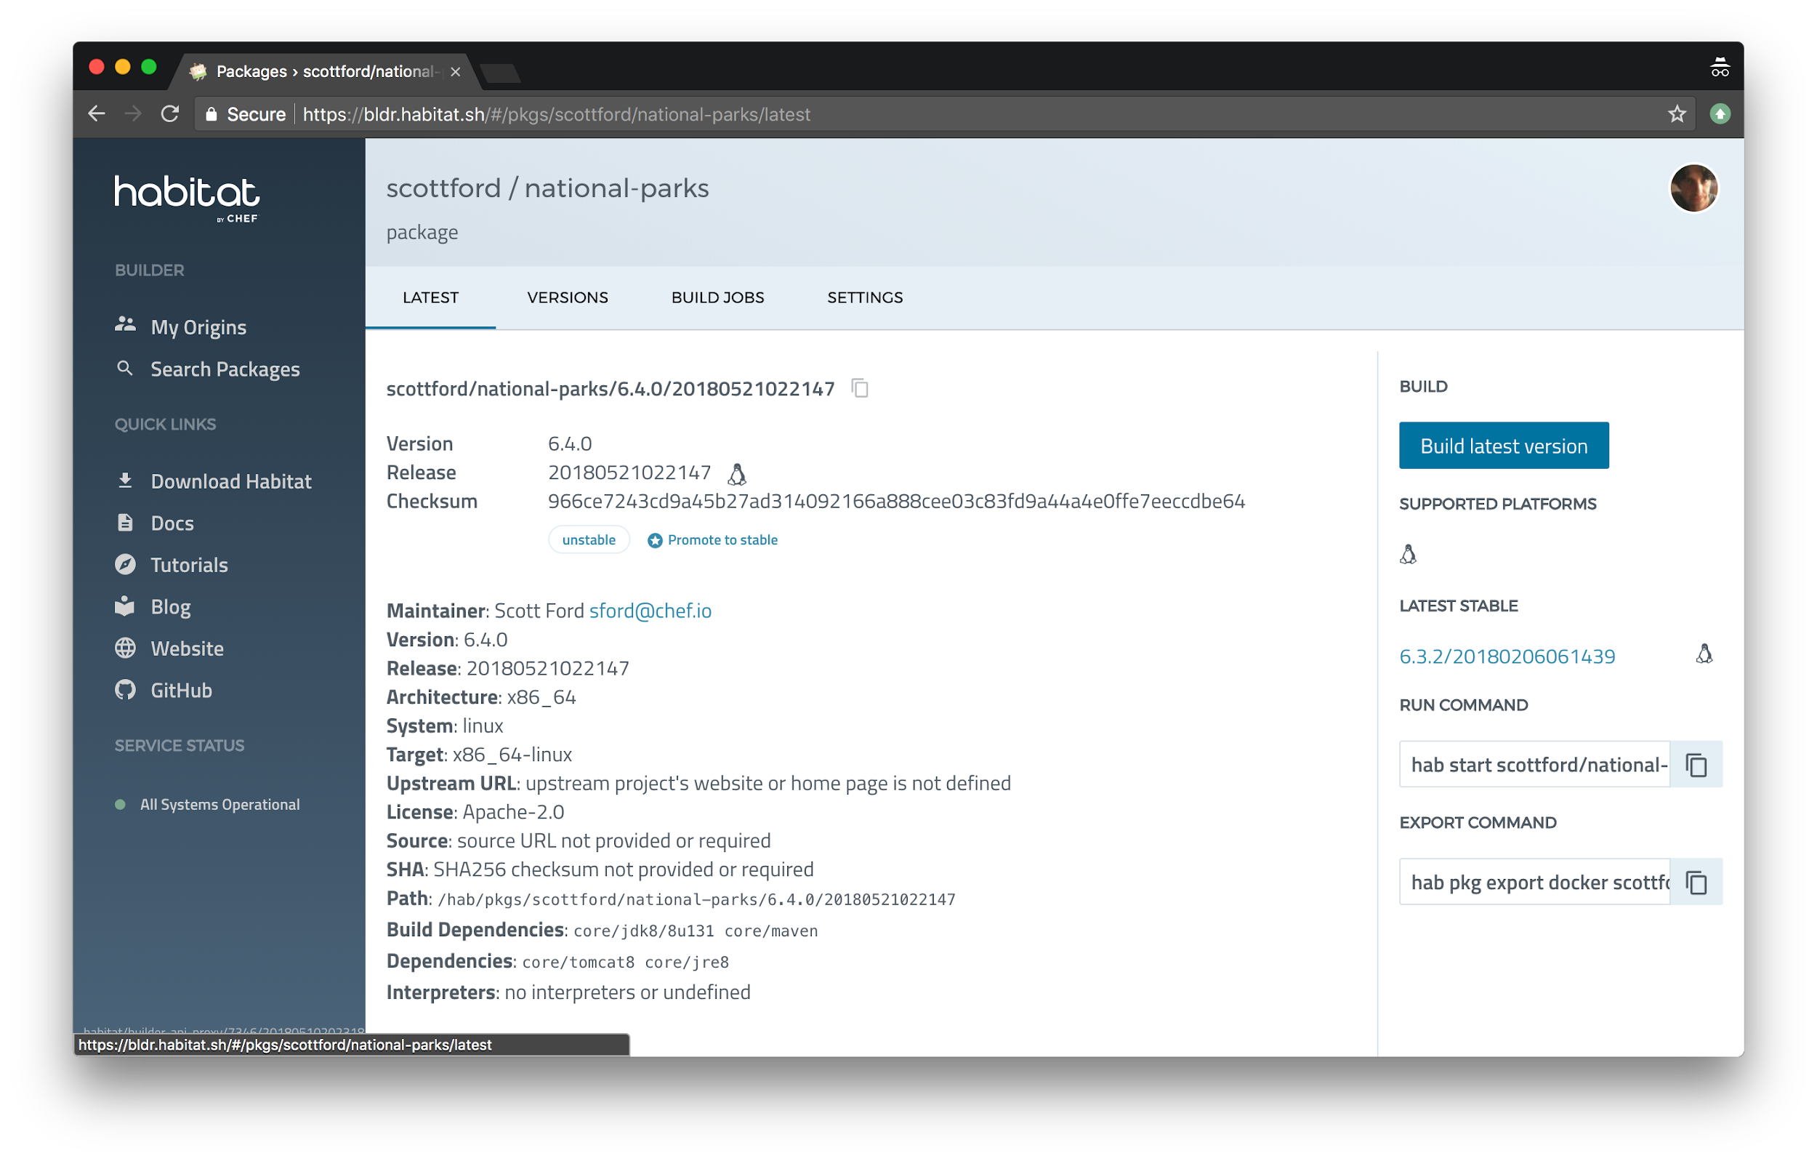
The merged PR triggers a new pkg build in Builder

Slide 109
9. Promote your new build to the Stable channel

Slide 110
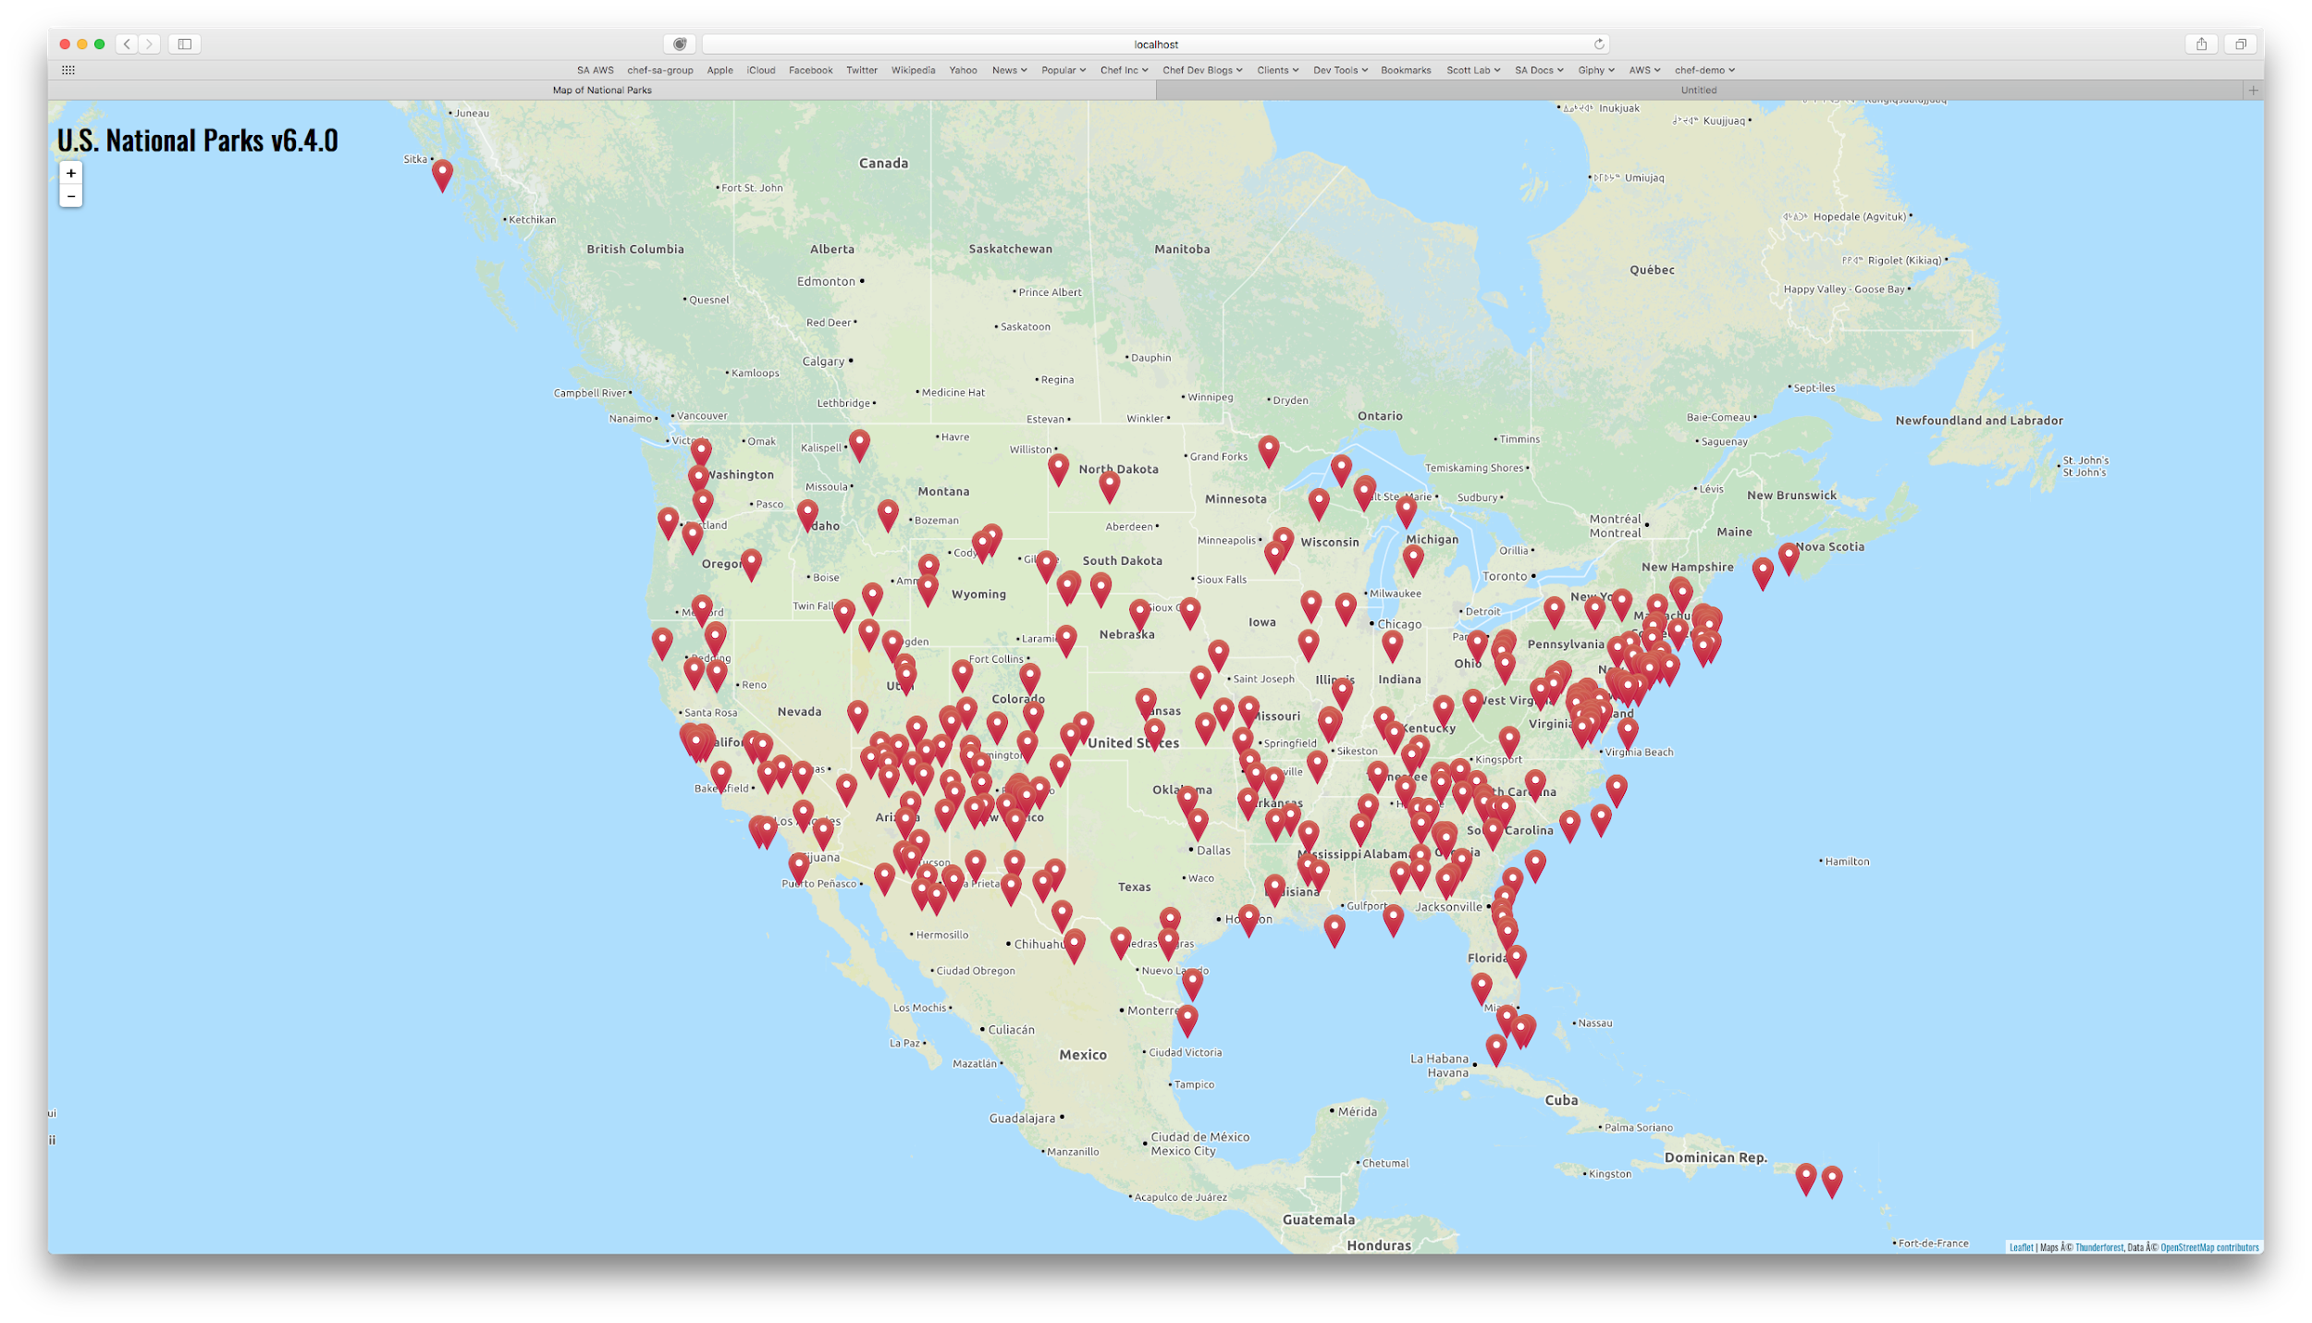
Reload app in the browser to see the updated version
http://<YOUR_WORKSTATION_IP>:8085/national-parks
Park locators should
now be RED

Slide 111
Habitat loves Windows!

Slide 112
Things to know
Win 7/2008 R2 and up are supported
hab studio enter behavior varies by environment
Will enter a Windows or Linux container depending on the container mode docker is running
Use a -w to enter a local container
Plans and hooks are written in Powershell (core 6.0.0)
Supervisor can run as a Windows Service
Supervisor rings can include both Windows and Linux Supervisors that share configuration and bind to one another
We have created plans for SQL Server, IIS based ASP.Net apps, Delphi apps and COM/COM+ applications - all can be exported to a Windows container

Slide 113
Habitat learning resources
Docs and Tutorials: https://www.habitat.sh/
Forums: https://forums.habitat.sh/
Slack: http://slack.habitat.sh

Slide 114
Self study
Encrypting configuration data (https://www.habitat.sh/docs/using-habitat/#using-encryption)
Running the Supervisor as a service (https://www.habitat.sh/docs/using-habitat/#running-the-supervisor-with-a-hosts-init-system)
Monitoring services and Supervisor REST API (https://www.habitat.sh/docs/using-habitat/#monitor-services)
Container environments (https://www.habitat.sh/docs/best-practices/)

